Slide 1

The Gambia
SMC Alliance Annual Meeting 2025
Lomé – Togo
Feb, 25 – 28, 2025
Experiences with increasing the age ranges

Slide 2
Malaria Epidemiology
Malaria is endemic, with the whole population at risk of infection
Transmission is highly seasonal and most cases (>90%) occur in the later part of the rainy season from October to December
2017 Malaria Indicator Survey (MIS) indicated that malaria prevalence increased from 0.1% in 2017 to 0.8% in 2024 among children aged 6-59 months

Slide 3
Changing Epidemiology
Number of uncomplicated malaria cases is decreasing.
Number of severe cases and deaths has significantly declined.
Transmission is becoming more focal (regional and district level).
Age distribution of cases is changing with the relative burden of disease growing amongst 5-14 years.

Slide 4
Malaria Incidence per 1000 population

Slide 5
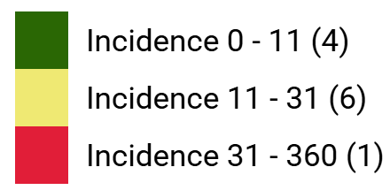
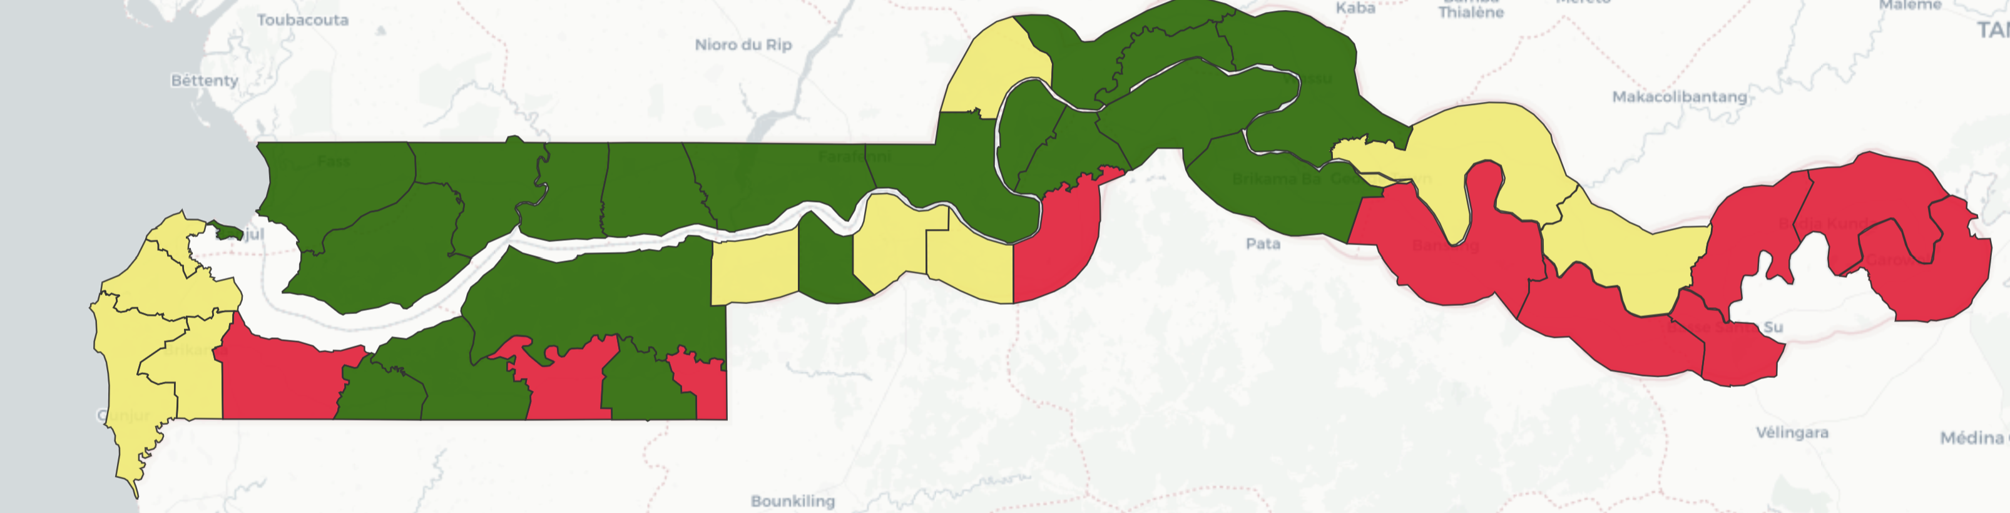
Malaria Incidence 2019

Slide 6

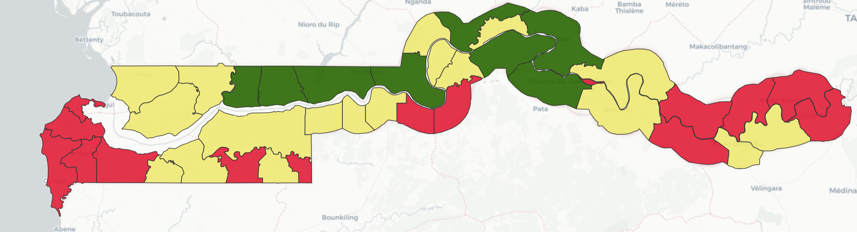
Malaria Incidence 2024

Slide 7
IMPACT SMC PROJECT
NMCP in partnership with CRS piloted SMC implementation for children 60-120 months in 6 districts (2 in CRR and 4 Districts in URR) funded by IMPACT SMC project
The aims of the project was to:
Contribute to the geographic expansion of SMC to all eligible areas
Evaluate the feasibility and incremental cost-effectiveness of including children aged 5 up to 10 years

Slide 8
Delivery methods & approaches
Door-to-door delivery strategy was used
Distribution team consist of two: Data collector and drug distributor (CHW)
CHNs, PHOs and OICs were used for the different levels of supervision
Community sensitization and radio Spot used to increase awareness and acceptance of SMC
Data collected digitally using Android Phones

Slide 9
SMC Coverage for Children 60-120 Months
Results 2022
Results 2023
2022 SMC Results
Region | District | Target | Cycle 1 | Cycle 2 | Cycle 3 | Cycle 4
CRR | Sami | 4639 | 3376 | 2412 | 1809 | 1531
CRR | Upper Fulladu West | 8840 | 6190 | 4420 | 3270 | 2829
URR | Upper Fulladu East (Basse) | 9855 | 4148 | 3548 | 2759 | 1872
URR | Jimara | 8723 | 5324 | 3664 | 3140 | 2093
URR | Kantora | 7698 | 3386 | 3464 | 2617 | 2078
URR | Tumana | 7467 | 4327 | 3210 | 2688 | 1941
Total |  | 47222 | 26751 | 20718 | 16283 | 12344
2023 SMC Results
Region | District | Target | Cycle 1 | Cycle 2 | Cycle 3 | Cycle 4
CRR | Sami | 4731 | 2363 | 2051 | 1838 | 1864
CRR | Upper Fulladu West | 9070 | 4102 | 3522 | 3140 | 3246
URR | Upper Fulladu East (Basse) | 10111 | 2 959 | 2199 | 1693 | 1503
URR | Jimara | 8949 | 3233 | 2408 | 2076 | 1818
URR | Kantora | 7898 | 2349 | 1736 | 1429 | 1384
URR | Tumana | 7661 | 2829 | 2160 | 1744 | 1621
Total |  | 48420 | 14876 | 14076 | 11920 | 11436

Slide 10
Achievements
Implementation of SMC guided by malaria stratification at district level
Use of the android phones for on spot data collection at community level and the setting up of a data quality team to improve on data quality and to solve technical issues that might be encountered in the field while using the Androids devices
Daily feedback meetings helped in making day to day informed decisions on SMC implementation
Strong political commitment and good collaboration between NMCP and partners enhanced implementation and acceptance of SMC

Slide 11
Challenges
Inadequate financial resources to scale up SMC to other eligible regions
Refusal by caregivers for children to take SMC medicines
Not administering the SMC 2nd and 3rd doses at home by caregivers
Inadequate documentation and reporting of adverse drug reactions
Difficulty in reaching school aged children: The SMC strategy in The Gambia does not allow SMC distribution at schools.

Slide 12
Challenges Cont.
The incidence of Acute Kidney Injury in 2022/23 negatively impacted on SMC coverage due to:
    Increased in refusals by care-givers
    Increased in medication hesitancy by care-givers
Target population in some districts seems to be overestimated because the last census conducted was in 2013
SMC cycles coincided with peak time for farming activities

Slide 13
Way Forward
Support resources mobilization and/or advocate for additional resource allocation to extend SMC age to 10 years.
Awareness creation through sensitization of influential/opinion leaders, authorities, community members etc. on SMC and malaria prevention and control
Learn best practices from countries that have successfully implemented SMC in children above 5 years.

Slide 14
End
Thank you

