Slide 1
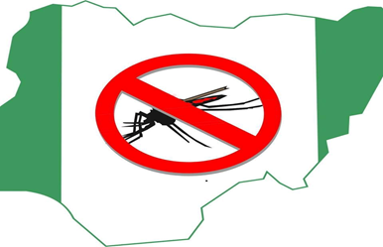
NIGERIA
SMC Alliance Annual Meeting 2025
Lomé – Togo Feb, 25 – 28, 2025
PERENNIAL MALARIA CHEMOPREVENTION (PMC): Experiences with Implementation

Slide 2
Presentation Outline
Background
Overview of the PMC effect study
Implementation summary & update
Some results from PMC process evaluation
Conclusion

Slide 3
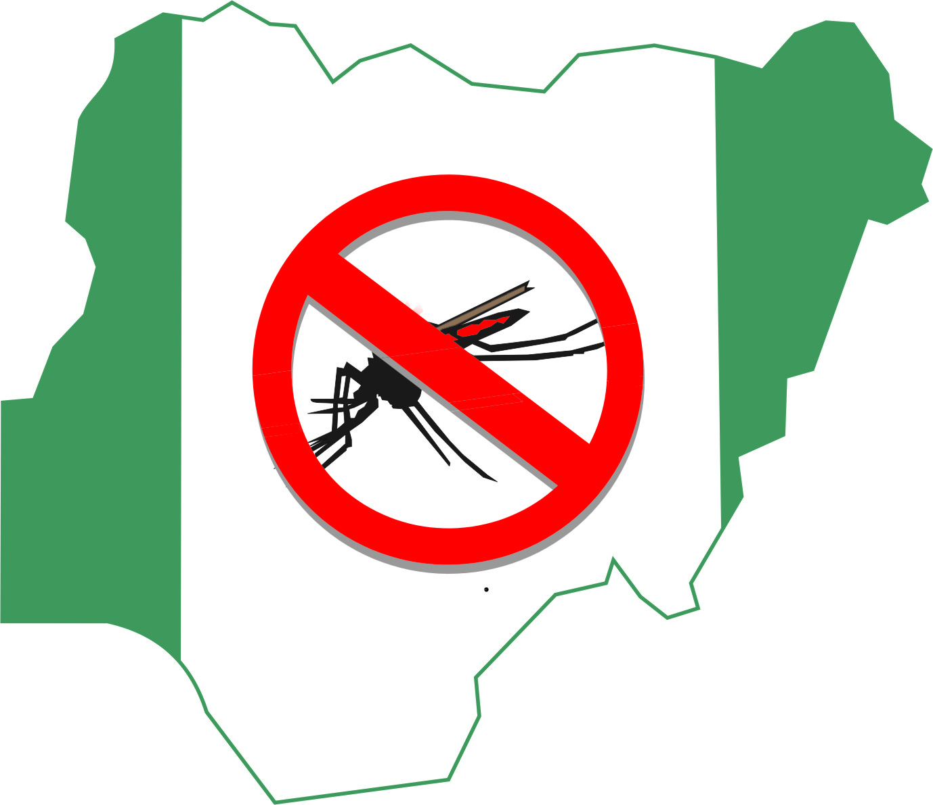
Background
Perennial Malaria Chemoprevention (formerly Intermittent Preventive Treatment for Infants ) is the administration of a full course of an effective antimalarial treatment to children at risk of malaria at specified time points, with the objective of reducing the malaria burden” (WHO, 2022)
WHO recommends administration of SP- PMC-at regular intervals of at least 4 weeks apart in sub-Saharan Africa:
In areas with moderate-to-high malaria transmission
For children up to 24 months

Slide 4
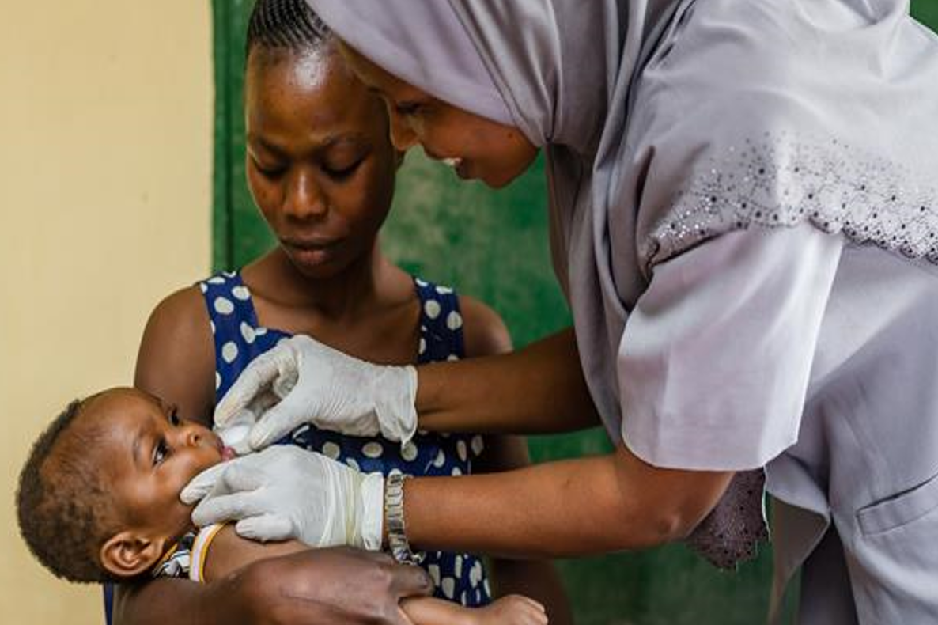
Background
Globally, Nigeria accounted for 25.9% of global malaria cases and 30.9% of estimated malaria deaths in 2023(WMR,2024)
The country is gathering evidence on the operational feasibility and impact of Perennial Malaria Chemoprevention (PMC) malaria incidence and related clinical outcomes with support from Malaria Consortium
It is a cluster-randomized hybrid effectiveness-implementation research study
1. World malaria report 2024. Geneva: World Health Organization; 2024

Slide 5
Areas Eligible for PMC in Nigeria
1. World malaria report 2024. Geneva: World Health Organization; 2024

Slide 6
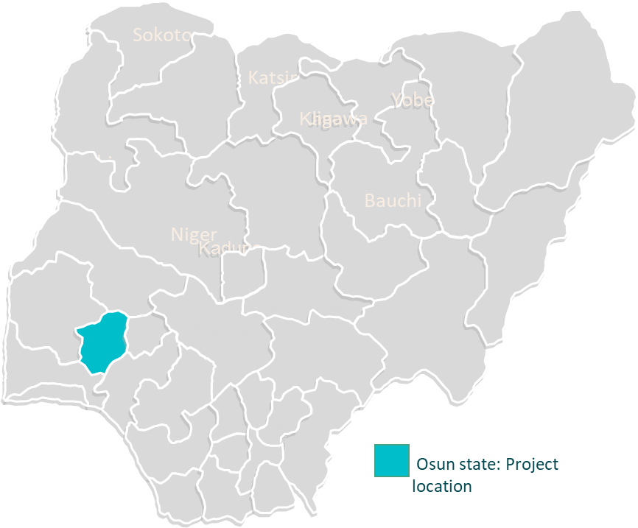
Overview of the PMC Study
Donor
Bill & Melinda Gates Foundation (BMGF)
Implementer
NMEP and Malaria Consortium
Length of project
4 years
Partners
Federal Ministry of Health
National Primary Health Care Development
Agency (NPHCDA)
National Malaria Elimination Program (NMEP)
National Agency for Food and Drug Administration and Control (NAFDAC)
London School of Hygiene & Tropical Medicine
Nigerian Institute of Medical Research (NIMR)
Northwestern University

Slide 7
Project purpose, design, objectives and end-points
Purpose
To catalyze decision making in Nigeria regarding the policy adoption of PMC
Design
Hybrid effectiveness-implementation design (Type 2)
Two-arm cluster-randomized controlled trial
Objectives
Measure the effectiveness of PMC when delivered through the EPI and other complementary platforms
Assess the operational feasibility of implementing PMC, and identify context-relevant solutions to key barriers
Assess the cost-effectiveness of the models of PMC delivery
Primary endpoints
Impact end-points:
Incidence rate of parasitologically-confirmed clinical malaria cases in children 2-18 months presenting to selected sentinel facilities over the first 18 months of implementation
Protective effectiveness of SP treatments as measured by the percentage reduction in the incidence of malaria associated with receipt of SP in the last 28 days
Feasibility end-points
For each scheduled dose of SP, the percentage of children who received the dose in question on time or within four weeks following the scheduled date

Slide 8
Description of intervention
Intervention
Health facility staff were trained to offer six scheduled doses of SP linked to the EPI and vitamin A supplementation at 10wks, 14wks, 6mo, 9mo, 12mo and 15mo
Additional ‘pragmatic’ (unscheduled) doses are offered whenever eligible children visit the facility outside of the EPI & VAS schedule up to 18 months of age
Pharmacovigilance
Passive adverse event (AE) reporting will be implemented in all study facilities
Active AE monitoring in a cohort of children will be implemented in two health facilities in each study arm
Sentinel surveillance
One HF per ward selected
HMIS reporting strengthened in these sites
HMIS tool (Child Health Register) will be used to record PMC data

Slide 9
PMC Dosing Schedule

Slide 10
Questions the study wants to answer
Is there a measurable reduction in malaria morbidity in children 10 weeks to 24 months after the introduction of SP-PMC?
Is the implementation of SP-PMC feasible at scale in Nigeria?
Are there considerable rebound morbidities after the last dose of PMC-SP at 15 months (14-16 months)
Does uptake of SP-PMC have a measurable impact on moderate to severe anemia among infants?
Does the inclusion of multiple additional touchpoints increase the clinical effectiveness of SP-PMC?
What are the cost and cost-effectiveness of scaling up SP-PMC?

Slide 11
Study Framework

Slide 12
Results: One-year implementation of PMC from September 2023 to August 2024
Overall, 19,429 doses have been given to children with EPI vaccination, while 3,646 doses have been given as unscheduled doses.
Caregivers are bringing their children to receive unscheduled additional doses of SP.
Total
Unscheduled: 3,646
Scheduled: 19,429

Slide 13
PMC data flowchart
National Malaria Data Repository
The National Malaria Data Repository (NMDR) platform, built using DHIS2 features, is used for collection, storage, analysis and visualization of PMC data.
Trained research assistants report PMC routine data electronically from the health facility into NMDR.
Using the Med safety app, health workers report adverse drug reaction data to the National Agency for Food and Drug Administration and Control (NAFDAC) database.
Malaria Consortium Project Result System
NAFDAC database
COUNTRY LEVEL
Adverse event monitoring
Case-control study
Private health facilities
Baseline, endline household survey, process evaluation health facility survey
HEALTH FACILITY LEVEL
Sentinel health facilities
Child immunisation register
Vaccine management tool

Slide 14
Some results from PMC process evaluation: qualitative component

Slide 15
Objectives
Explore the barriers and enablers for SP-PMC implementatio​n
Document experiences and perceptions of key stakeholders on SP-PMC implementation​
Questions
What are the key barriers and enablers to the successful implementation of PMC at the community and health facility levels, and how do they impact the delivery and uptake of the intervention?
What challenges have been encountered in the implementation of SP-PMC, particularly concerning training, logistics, and contextual factors and how have these challenges impacted the intervention’s feasibility?
Method
Qualitative exploration through focus group discussions and KIIs
Participant selection
The study included 22 FGDs and 6 KIIs making a total of 28 qualitative interviews
Participants were selected from 4 communities each from 4 wards from 4 randomly selected intervention LGAs including:
Caregivers of children <24 months
Community local leaders (traditional leaders, religious leaders (Christian, Islam and traditional)), women leaders
Fathers of children <24 months
State ministry of health officials

Slide 16
Barriers to PMC implementation
Health worker and health facility-related barriers
Limited staff strength
Demand-side barriers
Community-related barriers
Caregivers competing responsibilities
Limited knowledge of SP-PMC efficacy in preventing malaria
Excess workload
Logistics challenges particularly reaching remote areas
Economic challenges
Low attendance at scheduled contacts
Attitude of health workers
Misinformation and ignorance about SP-PMC
Rigid scheduling of SP-PMC services

Slide 17
Enablers of PMC implementation
Involvement of husbands
Involvement of community leaders
Accessibility to health centre
Role of health workers
“What I have to say is that, when my wife is planning to go and collect the vaccine and SP for the child, she normally tells me a day before, and gives me time to prepare myself create time to drive her and the baby to the health centre...” (FGD with Fathers of U24 _Edunabon)
‘I'm one of the community leaders that is responsible for the growth of the community and all these people of ours they work hand in hand with our health workers..’
(FGD with Community Leaders_Gidigbo_Iwo)
“accessibility is also a part of it, the health center where they are located is accessible, they can trek there anytime when they are given the date for their next appointment, … It’s not as if money is a problem, saying …
(KII with RBM_Ede South)
“We thank our healthcare providers’ they are doing very well in terms of our health... They make us know how we can take care of our children without any issue in the family or community, so they are doing well. They reach out to community members in the church and mosque that we should take good care of our children especially during raining season that they need to cover their bodies to prevent mosquito bites.” (FGD with Community Leaders_Ayedaade)

Slide 18
Experiences and perceptions about SP-PMC implementation​
Caregivers’
Decline in malaria incidence among children
“What I can say on it is that before now, most of the time, we mothers rush our children to the maternity when their body temperature is high or other health related complaints so taking the drugs has drastically reduced the way we frequent the maternity.
(FGD with Caregivers_IJugbe-Amala_Ayedaade)
Protection from malaria
“What I want to say is that the day I brought my child, he had a high temperature coupled with malaria already, and they were giving the drug to other children that same day. I was asked to treat malaria first, that SP only prevent malaria and not cure it. I treated the malaria first, after which I brought him back to the hospital, and he was given the drug. thank God he has been okay since then. He has been bitten by a malaria parasite several times afterwards, and he is okay. “
(FGD with Caregivers_Gidigbo_Ward 1_Iwo)

Slide 19
Experiences and perceptions about SP-PMC implementation​
Health Workers’
Community leaders’
Reduction in malaria cases and workload
“The one that has changed is that the malaria cases has reduced. So, the mother will not complain that this child has malaria, It has reduced. So it has reduced our work in this health facility”
(KII with RBM_Ife North)
Improved healthcare utilisation and uptake of routine immunisation efforts.
“It gives us the advantage to have increasing number of people to patronize us and it gives us like 70% success on our routine immunization”
(KII with OIC_Gidigbo_Iwo)
It works
“I've heard about it, and we've seen cases of children that used it, and it works effectively in their body because in the old days, there was no such drug but since the drug is available malaria doesn't affect our children again so we commend the government for that.”
(FDG with Community Leaders_Gidigbo_Iwo)

Slide 20
Conclusion
PMC implementation is progressing satisfactorily in Nigeria
Feedback from the benefiting communities and implementing health facilities have been positive.
Nigeria looks forward to scaling up this intervention as soon as all evidence on operational feasibility and effectiveness have been compiled.

Slide 21
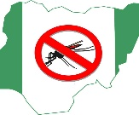
Acknowledgements

Slide 22
Merci, Akpe, Thank you, Obrigado

