Slide 1
Reaching 10M children within 10 Days
National Malaria Elimination Programme, NMEP Nigeria
Leveraging personal devices to achieve scale
8th SMC Alliance Annual Meeting | Lomé, Togo
February 2025

Slide 2
Innovation Driven Operational Excellence
RedRose is the leading global partner for governments, iNGOs, and UN organizations, providing IT solutions for Mass Health Campaigns and Cash and Voucher Assistance.
Europe
Bulgaria Hungary
Greece Lithuania
Montenegro Moldova
Poland Romania
Slovakia Turkiye
Ukraine United Kingdom
Middle East North Africa
Jordan Iraq
Lebanon Libya
Palestine Syria
Caribbean /South Americas:
Aruba
Colombia
Guatemala
Haiti
St. Maarten
Venezuela
With experience in over 60 different countries our services are highly scalable and adaptable with a minimum amount of configuration.
Pacific
Indonesia
Philippines
Sub-Saharan Africa
Burkina Faso Burundi
Benin Cameroon C.A.R. Chad Ethiopia D.R.C.
Kenya Liberia
Mali Malawi
Mauritania Niger
Mozambique Nigeria
Rwanda Somalia South Sudan Sudan Uganda Zimbabwe
Asia
Afghanistan Bangladesh
Malaysia Myanmar
Nepal Pakistan Thailand Vietnam
Our expertise offers unparalleled insight, enabling us to tailor our platform to fit almost any program's unique context.

Slide 3
History and Structure of Redrose
Company Formation
First Mass Campaign
ONEsolution
Tech + Financial Services
(v2.0)
ONEsolution
Tech + Financial +
Other Services
(v3.0)
ONEsolution
Tech + Ecosystem
(v4.0)
2014
2015
2016
2017
2018
2019
2020
2021
2022
2023
2024
First Programs Tech-Only
(v1.0)
RedRose as a Financial Service Provider
+10 million registrations in 7 days
+23 Million children reached +327 Million SPAQ distribution recorded SMC/ITN integrated mass campaign
Global Offices
Ireland
Nigeria
Turkiye
Ukraine
UK
USA (within 2024)
Key Departments of RedRose
Client Partnerships and Success
B2B Service Partnerships
Strategic Partnerships and Donor Relations
Digital Innovations
Financial and Other Service Operations/Support
Technical and Operations Support
We Helped our Partners to Reach
200+ Million People
in
60+
Countries
“We are a mix of Humanitarians and Private Sector Professionals”

Slide 4
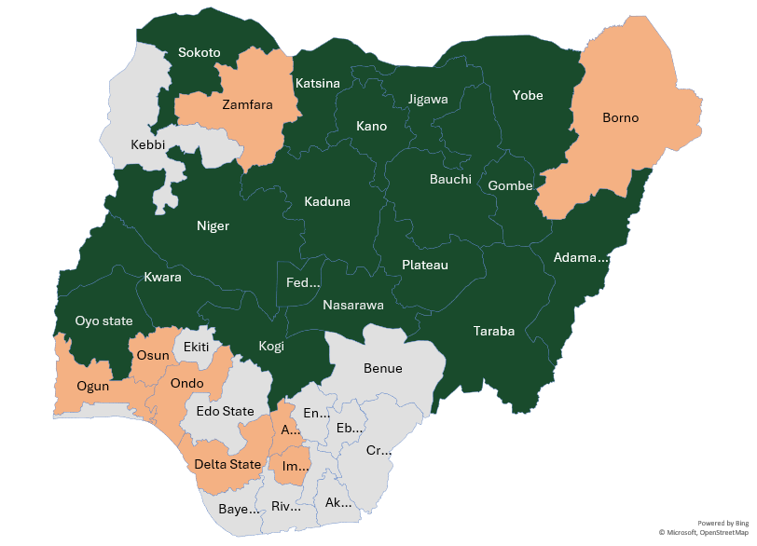
SMC Digitalization Scale up in Nigeria
Scale up of SMC digitalization in Nigeria
From over 800K Children tracked in 2021 To over 23M children tracked in 2024
2021
2022
2023
2024
Gombe
Gombe
Jigawa
Kano
Kwara
Gombe
Jigawa
Kano
Kwara
Katsina
Niger
Taraba
Yobe
Adamawa
Kaduna
Adamawa
Gombe
Jigawa
Kano
Kaduna
Kwara
Katsina
Niger
Taraba
Yobe
Sokoto
Nasarawa
Plateau
Bauchi
Oyo
Kogi
FCT
SMC Implementation
Other Projects

Slide 5
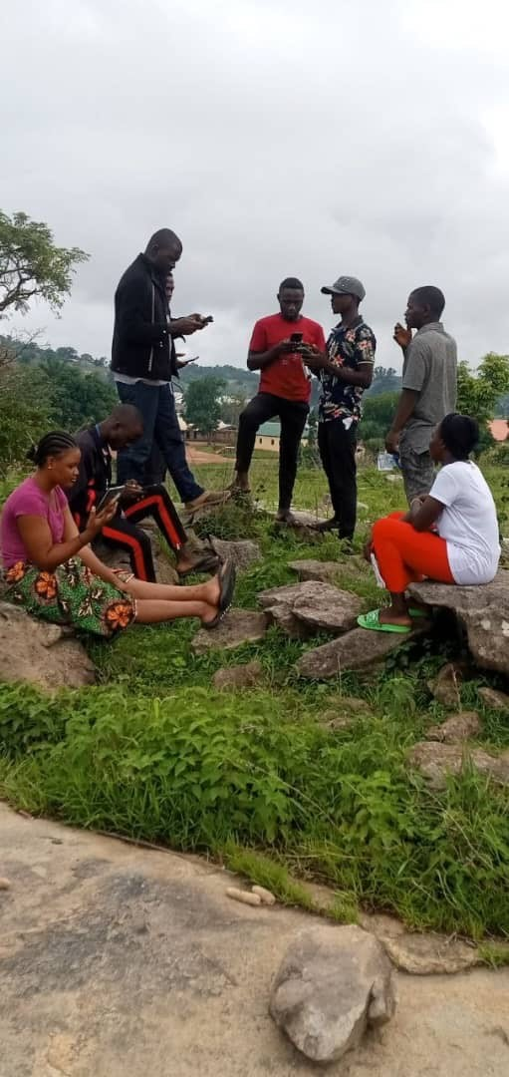
Bring Your Own Device
BYOD in a Mass health campaign implies:
Using personally owned, handheld mobile device that is configured with the necessary applications to enable a user collect data on the field.
Nigeria digitalized SMC Implementation Facts:
2021: Over 1,000 personal devices were used
2022: Over 10,000 personal devices were used
2023: Over 130,000 personal devices were used
2024: Over 160,000 personal devices were used
Less than 10% of buffer devices procured for emergency purposes were utilized
In 2024 alone, more than 40,000 personal devices were actively synchronizing and exchanging data with SMC servers simultaneously

Slide 6
Pillar & Merits of BYOD Approach
BYOD leverages on:
Users’ digital literacy and familiarity with technology.
Comfort and proficiency in using their personal devices for work-related tasks.
Existing charging routines and access to power sources for maintaining device uptime.
Personal data subscriptions and their knowledge of alternative methods for internet access in areas with limited mobile network coverage
BYOD Merits:
Cost-Effectiveness
Increased Participation
Flexibility
Convenience
Scalability

Slide 7
Digitalized Health Interventions employs People who are trained on the Process and use Technology to deliver the required results.
The KEY
Human Considerations People
Operational Considerations
Process
Technical Considerations Technology

Slide 8
Rubric Components Considered
People
Process
Technology
Security & Privacy
Digital literacy & smartphone availability
Advocacy & Stakeholder Engagement
Security & Privacy
Compatibility Evaluation
Training
Staff Turnover
Device Management
Pre-existing Processes
Socio-cultural Considerations
Complex Operating Environments
Security & Privacy
Device compatibility & Standardization
Network Infrastructure & Connectivity
Support & Maintenance

Slide 9
Human Considerations: People
Perception vs. Reality
Advocating against the established norm
It is a PERSONAL device
Outcomes changing attitude
Security & Privacy
Digital literacy & smartphone availability
Advocacy & Stakeholder Engagement

Slide 10
Process Considerations: Operations
For health projects, how many devices should health workers carry?
Managing the backup plan.
Will the data walk away?
Security & Privacy
Compatibility Evaluation
Training
Staff Turnover
Device Management

Slide 11
Process Considerations: Tricky Operations
How does using personal devices impact or change the socio-cultural practices?
Does BYOD make it easier or harder in Complex Operating Environments?
Pre-existing Processes
Socio-cultural Considerations
Complex Operating Environments

Slide 12
Technical Considerations: Technology
Since the application is on a person’s personal device, how do we ensure the privacy of collected data?
App requested permission
User metadata
Device compatibility standardization
Network Infrastructure & Connectivity
Support and Maintenance
Technical support
Software updates
Security & Privacy
Device compatibility & Standardization
Network Infrastructure & Connectivity
Support & Maintenance

Slide 13
Benefits and Challenges of BYOD
Benefits
Challenges
Reduced the need for procuring and distributing grant devices, thereby lowering campaign costs.
Minimized data entry errors and delays by allowing health workers to use familiar devices.
Enabled easy campaign scale-up by leveraging the widespread availability of mobile phones.
ONESolution was compatible with most personally owned mobile devices.
Personal applications installed like VPN, sometimes masks core device functionalities interfering with metadata collected on the device.
Users can manipulate device settings that may impact on data integrity.
Device functionality may be difficult to evaluate beyond compatibility checks.
The use of social media internet data bundle subscription

Slide 14
In Summary
Even with a rubric to help,
be ready for anything!
Cost-Effectiveness
Increased Participation
Flexibility
Convenience
Scalability

Slide 15
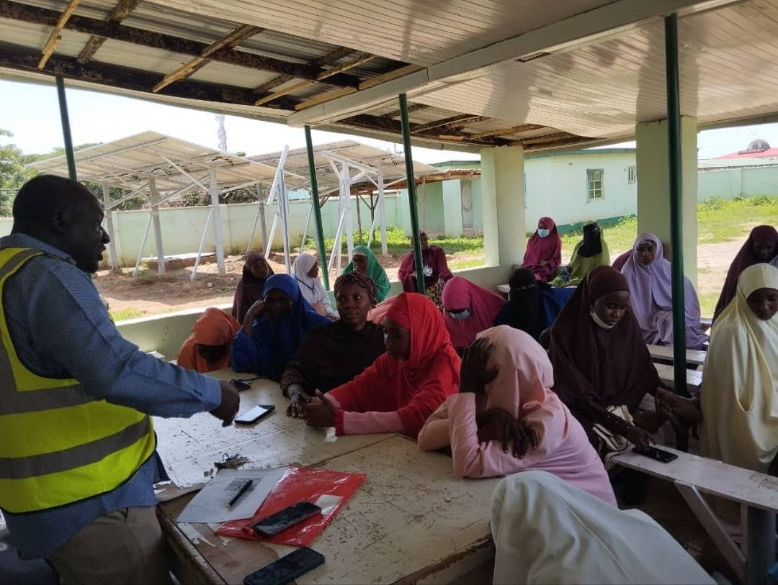
Conclusion
The BYOD approach, leveraging RedRose’s ONEsolution for Nigeria’s SMC mass campaigns across 10 states, proved scalable, sustainable, and cost-effective.
Reaching over 10 million children in just one week highlights the power of utilizing existing local resources and technology to drive impactful health interventions.
The key takeaway: impact can scale within existing budgets through smarter resource management, stronger local engagement, and co-innovative solutions that drive sustainable change.

Slide 16
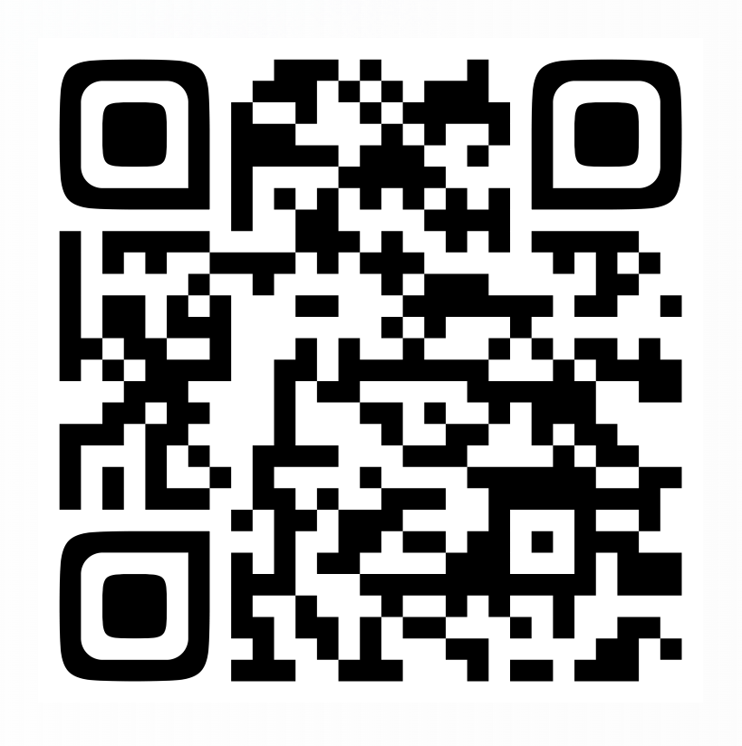
You can read more about the case study on LinkedIn using the QR Code

Slide 17
THANK YOU!!
MERCI!!

