Slide 1

NIGERIA
SMC Alliance Annual Meeting 2025
Lomé – Togo
Feb, 25 – 28, 2025
SEASONAL MALARIA CHEMOPREVENTION (SMC) Innovations in Monitoring: Cohort Tracking in 2024 Campaign

Slide 2
Presentation Outline
2024 Administrative Coverage Insights
2024 SMC Cohort Tracking insights
Innovations Implemented to achieve High Cohort Retention
Operational Challenges
Recommendations

Slide 3
Summary information for 2024 and plans for 2025 campaigns
 | 2024 | 2025
Start and end dates | June – Oct | June – Oct
Numbers of cycles | 4 cycles in 15 states 5 cycles in 6 states | 4 cycles in 15 states 5 cycles in 6 states
Numbers of districts targeted | 411 | 411
Numbers of children covered | 28,984,535 across the 15 states implementing 4 cycles and 6,262,072 across 6 states implementing 5 cycles (35,246,607)
Age ranges covered | 3 – 59 months (<5yrs) | 3 – 59 months (<5yrs)
Cohort Coverage (% targeted children receiving all cycles) | Cohort tracking fully conducted in 12 States, partially conducted in 8 states and not done in 2 state | Cohort planned in all states
Any drug resistance testing or efficacy studies performed? (Y/N) | Nil
Any gap | Yes

Slide 4
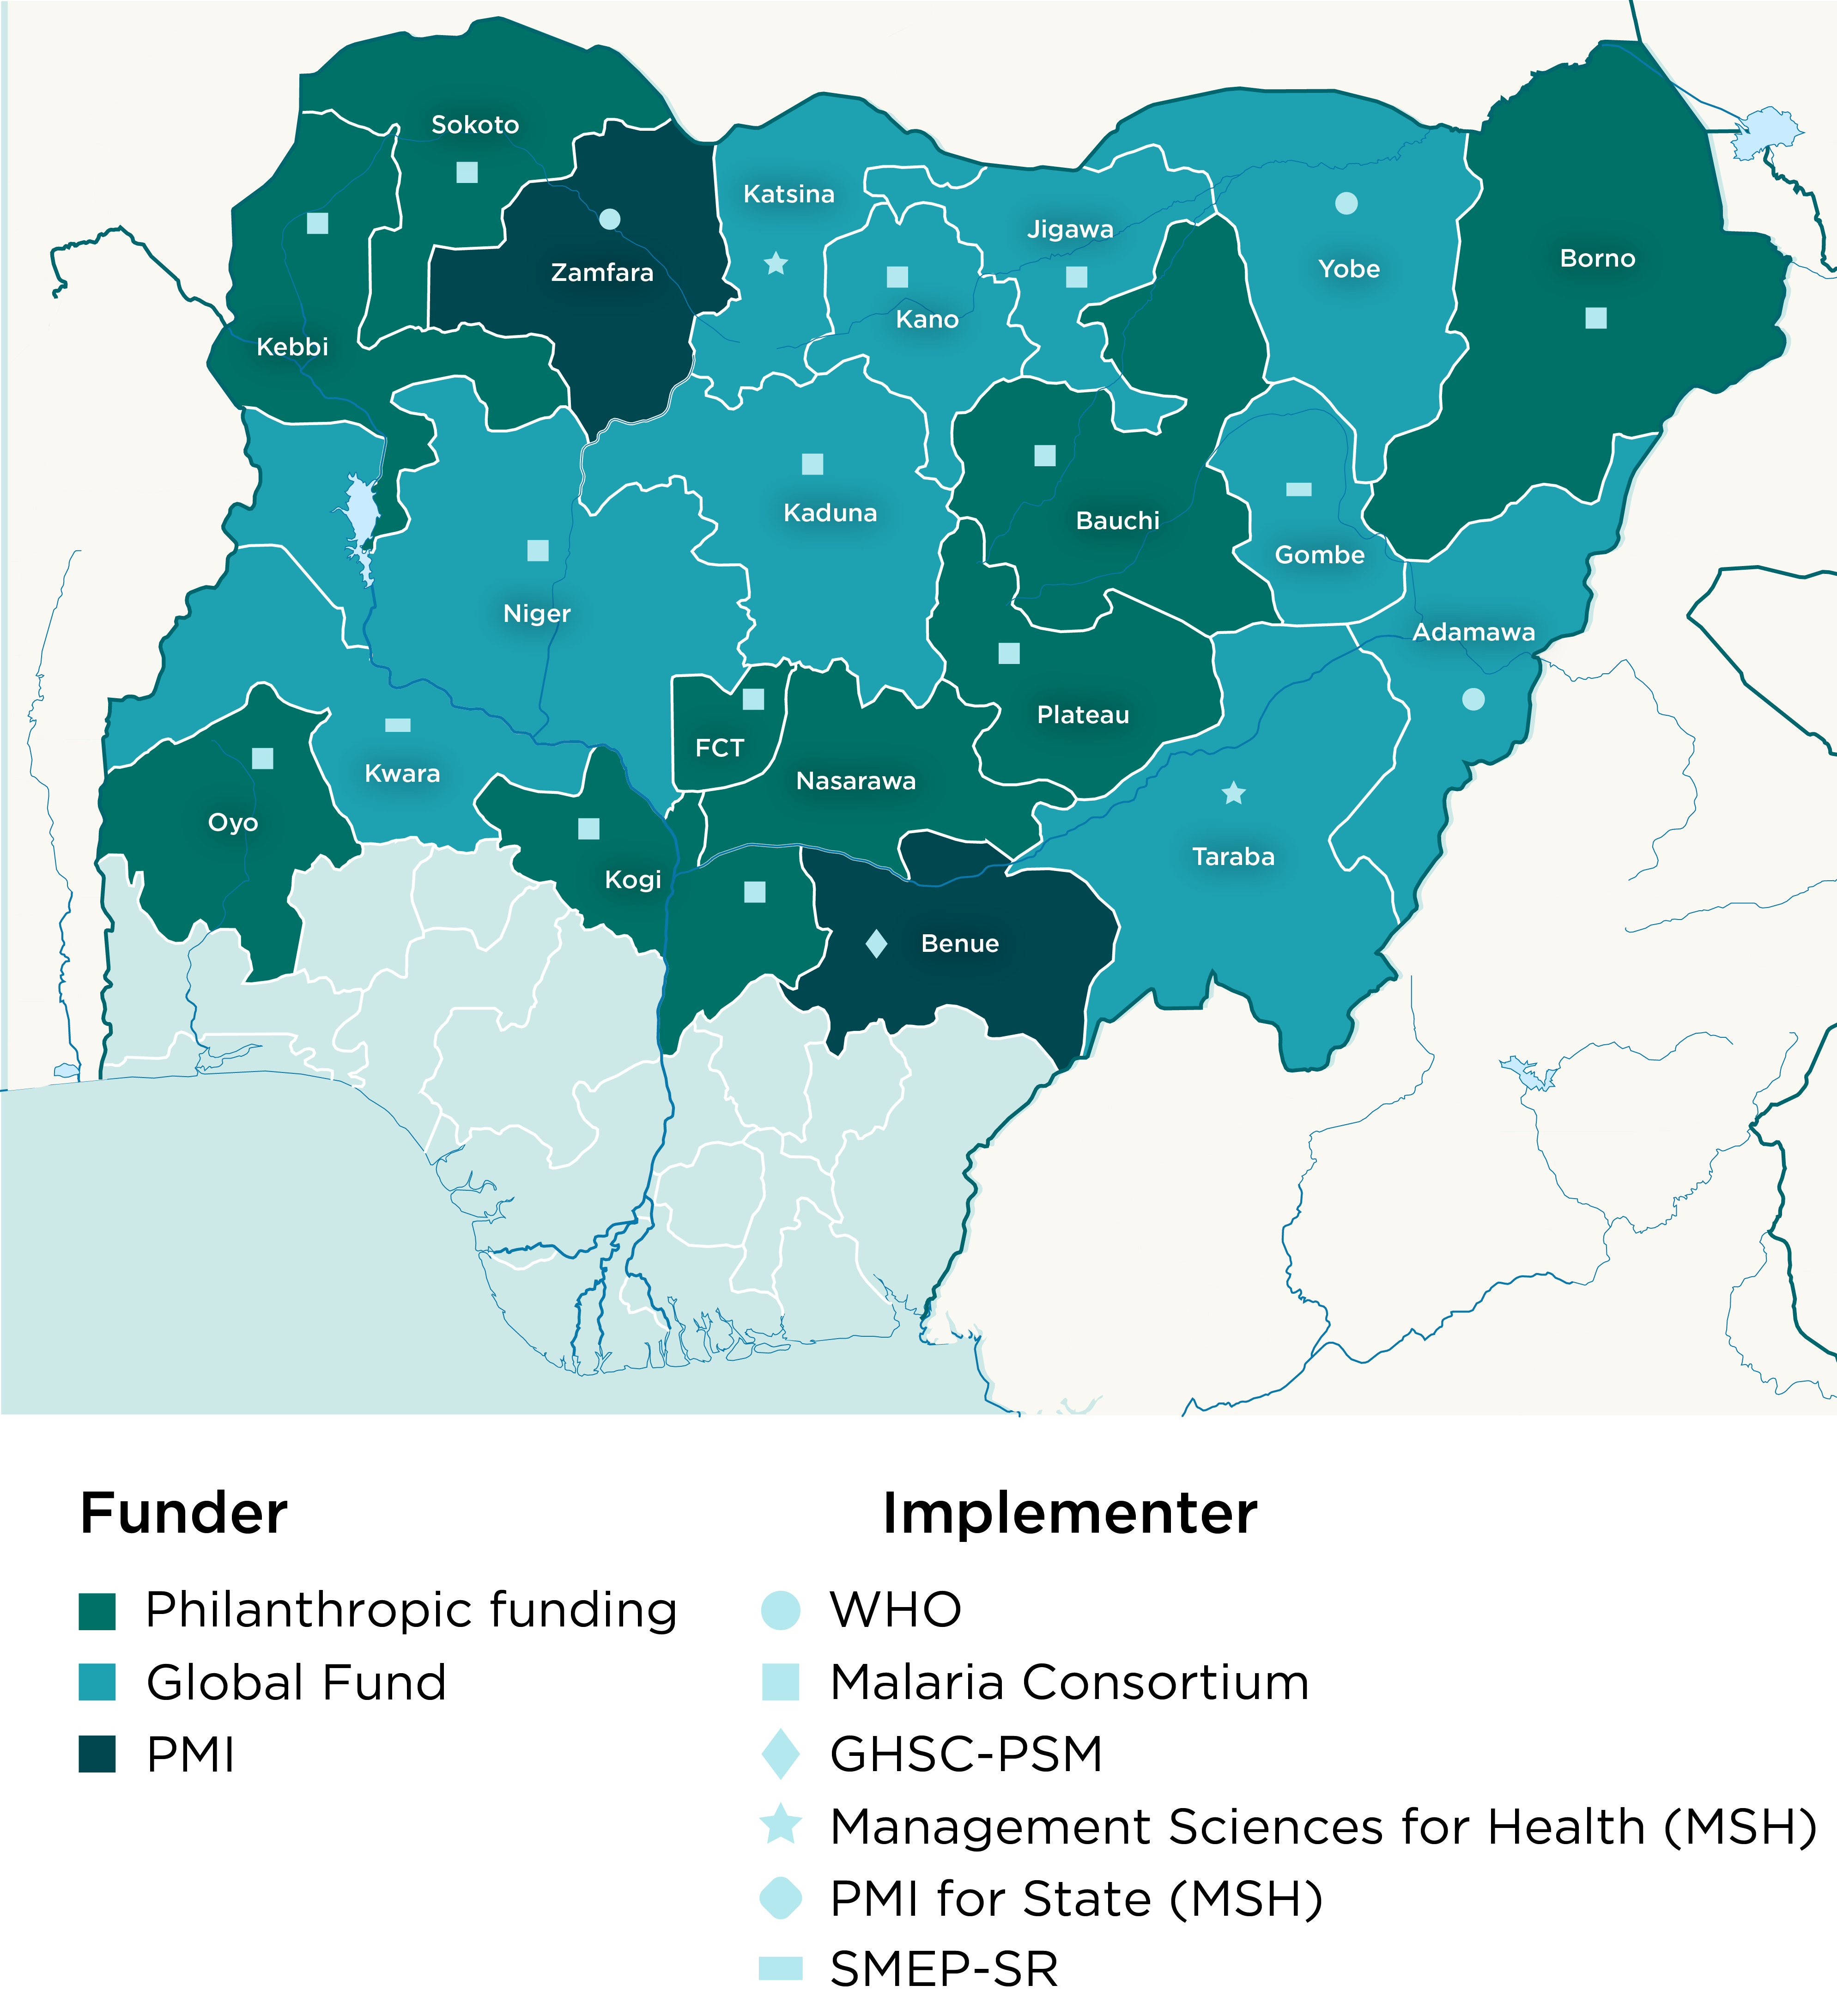
Country map showing SMC implementing districts
2024 map (covered)
2025 map (targets)

Slide 5
Coverage Cycle 1 2024

Slide 6

Coverage Cycle 2 2024

Slide 7
Coverage Cycle 3 2024

Slide 8
Coverage Cycle 4 2024

Slide 9
Coverage Cycle 5 2024
2
3
4
5
6

Slide 10
Nigeria Map Showing Cohort Tracking Implementation

Slide 11
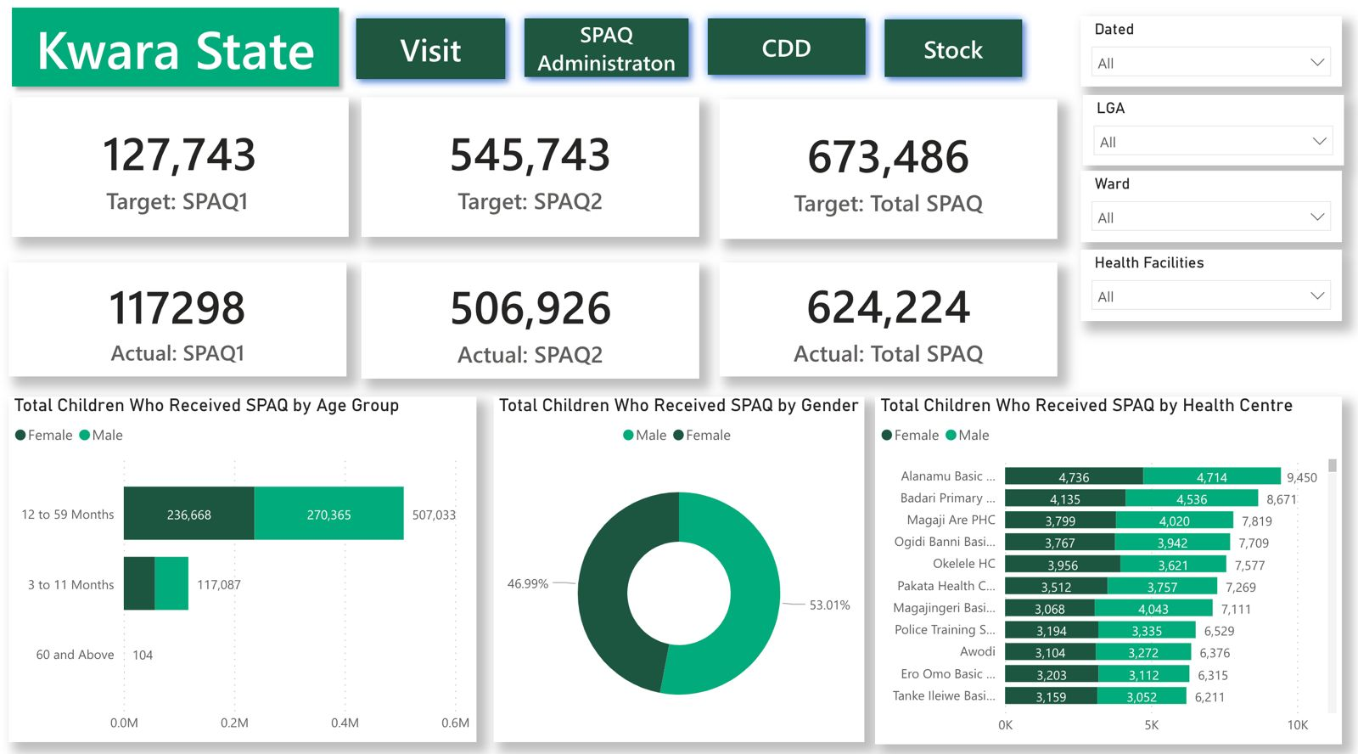
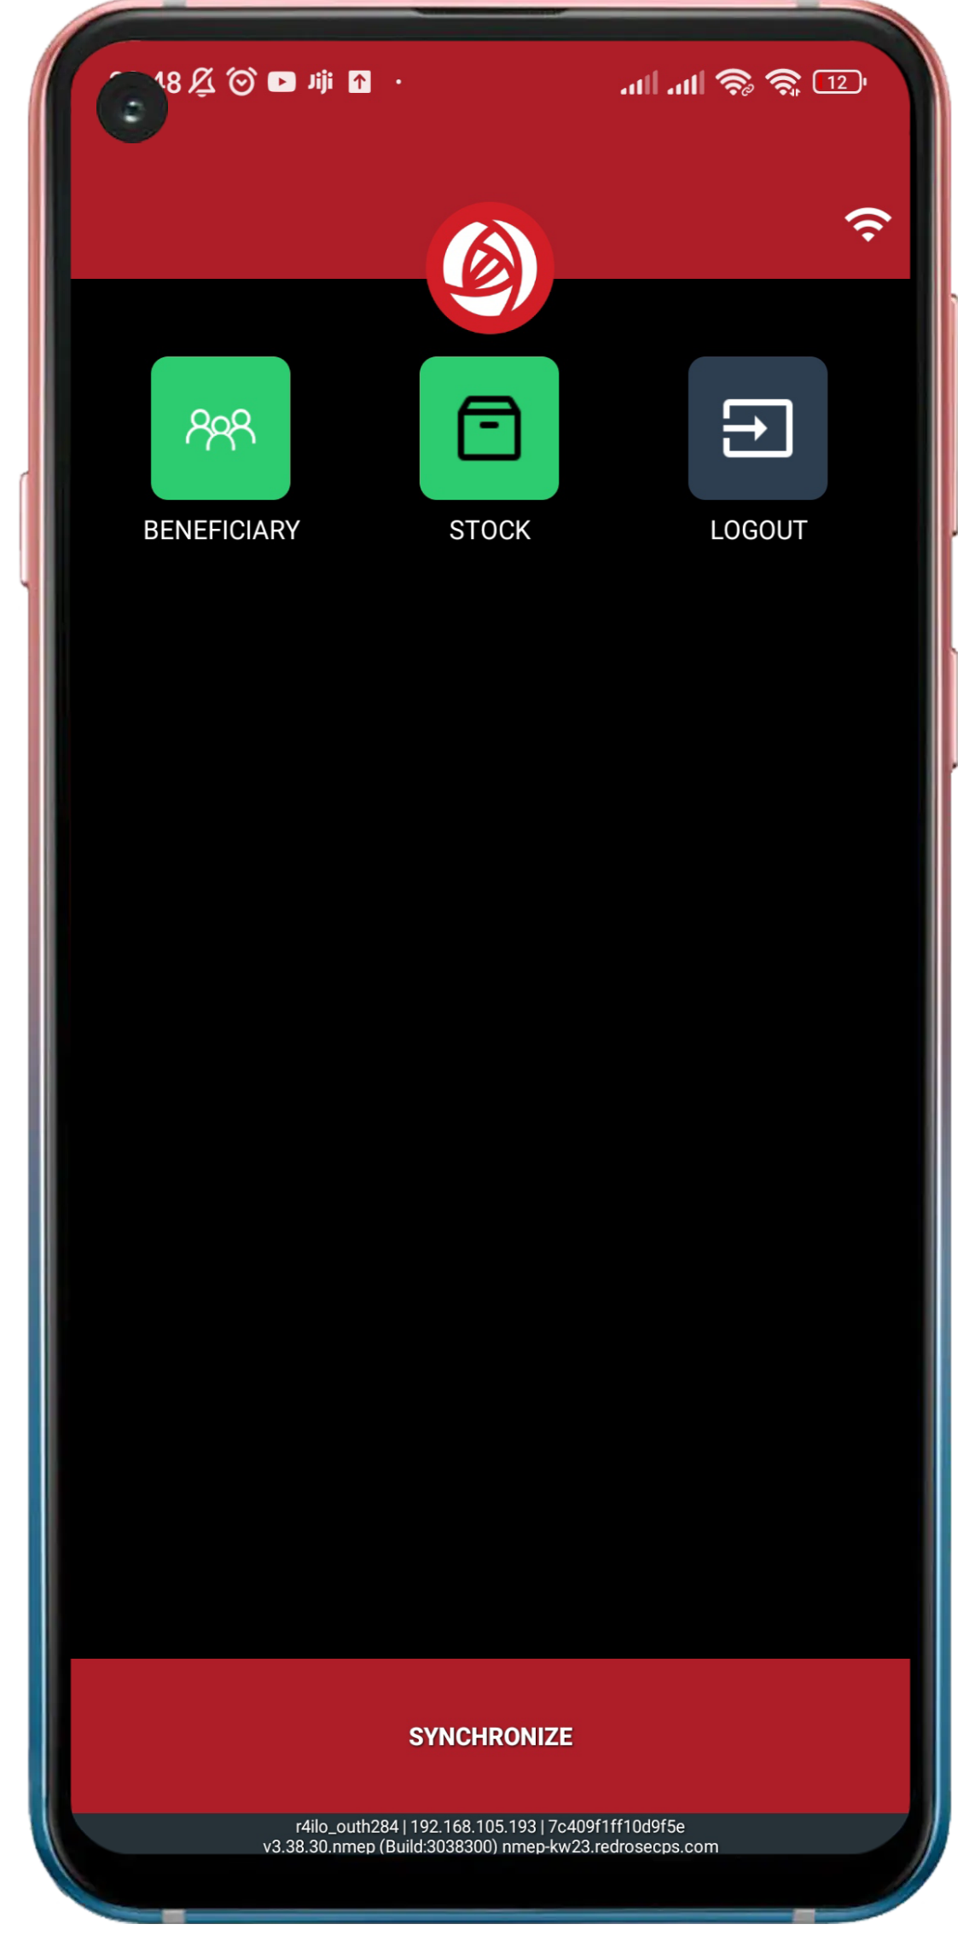


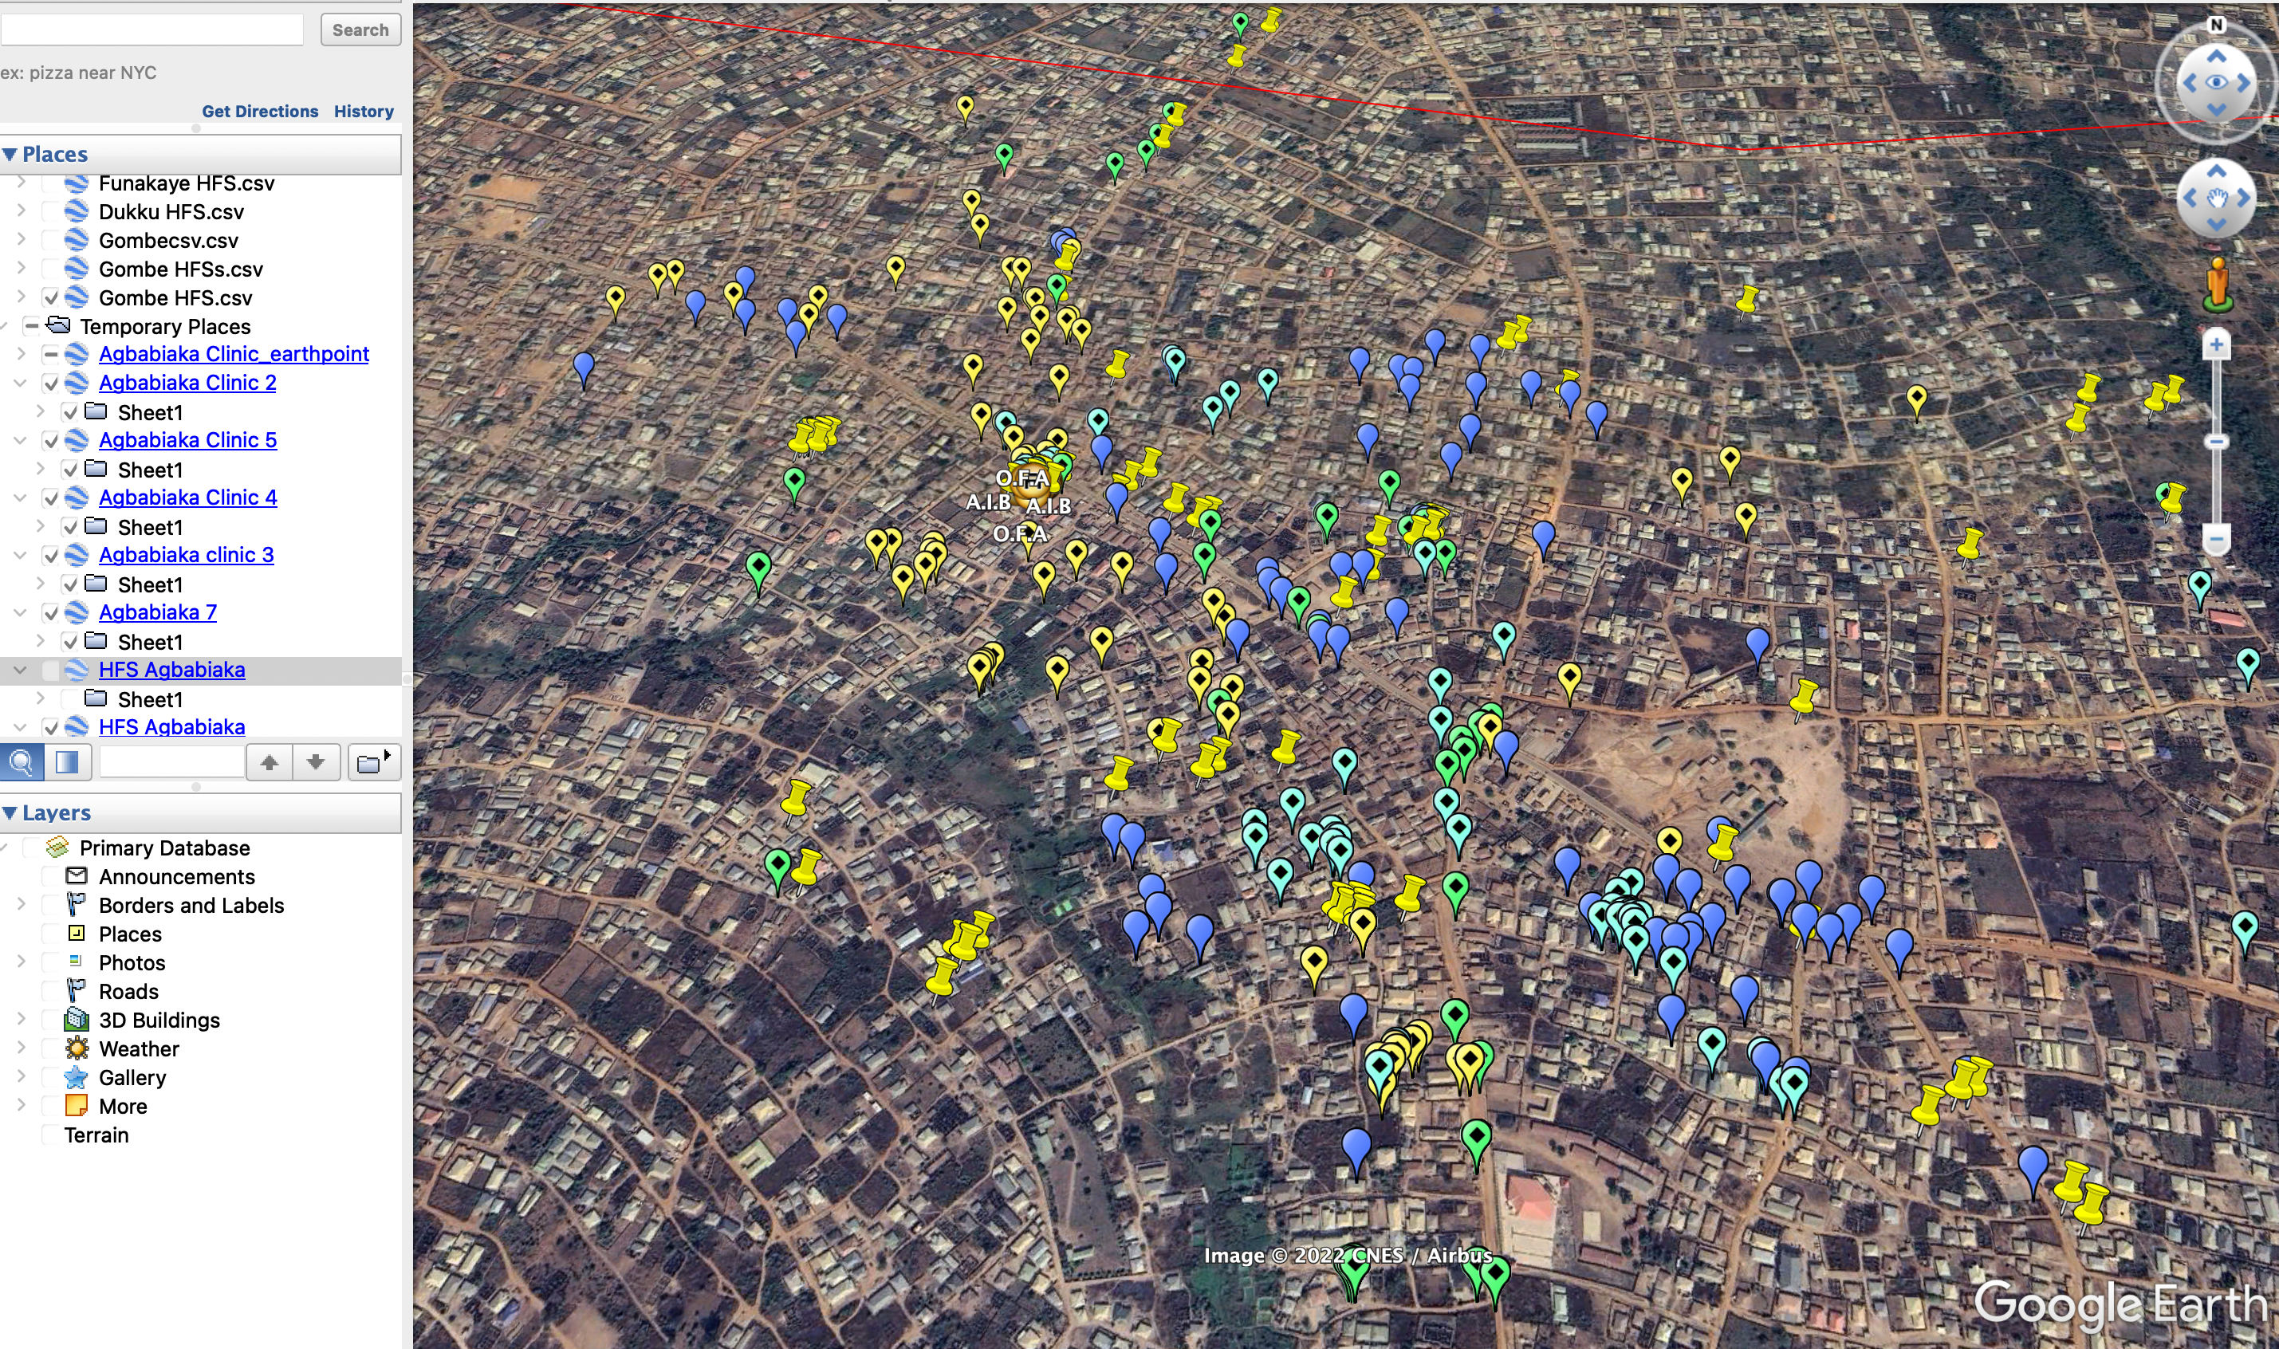
Digitization design
SPAQ Coverage Dashboard
NMEP One App
RRCollect
Geo- Spatial Tracking

Slide 12
Design of the Cohort tracking
Cohort Tracking
SMC cohort tracking has been possible with the use of Unique Beneficiary Identification (ID) assigned to each child’s profile on the ICT4D database/platform
The Beneficiary ID is a combination of numbers and alphabets used to identify each unique child on the ICT4D platform/Database. This has proven to be efficient in accurately identifying a child

Slide 13
CDD Level Cohort Tracking & Data Collection Process Flow
Training of CDDs
Curiculum to include sessons on cohort tracking with emphasis on practicals
Administer SPAQ, document on child record card & NMEP One App
Child not eligible
Do not assign unique ID
Do not enroll in the cohortt
Refer if needed
Implementation:SPAQ Administration
Determine eligibility of child between
3 -59 months
NO
YES
YES
For subsequent cycles 2,3,4
Request for child record card, if available, search child details using unique ID generated in cycle 1 or name of Head of HH
NO
Generate a unique ID & asign unique ID to an eligible child to be errolled in the cohort . Document on child record card
Missing child card
Replace with a new child record card
Do not assign new unique ID.
Use cycle 1 ID provided by TTA to search for child.
Document ID on child card
Educate caregiver on the importance of cohort tracking, unique ID and safe keeping of child record card
Administer SPAQ to eligible child
Document on child record card & NMEP One App

Slide 14
2024 SMC Cohort Coverage
State | Cycle 1+2 | Cycle1+2+ 3 | Cycle 1+2+3+ 4
Adamawa | 96.3% | 92.6% | 88.9%
Taraba | 96.0% | 92.3% | 88.7%
Kwara | 94.3% | 90.3% | 86.0%
Yobe | 87.6% | 79.4% | 73.5%
Niger | 90.3% | 82.8% | 77.1%
Katsina | 91.6% | 87.5% | 83.8%
Kano | 90.3% | 81.4% | 74.3%
Kaduna | 93.2% | 87.0% | 82.6%
Gombe | 82.1% | 74.7% | 68.6%
Jigawa | 85.9% | 76.1% | 66.8%
Benue | 82% | 76% | 66%
Zamfara | 78% | 68% | 65%

Slide 15
2024 SMC Cohort Coverage
State | Cycle 3 | Cycle 3 + 4 | Cycle 3 + 4 + 5
Bauchi | 102% | 97% | 90%
FCT | 98% | 94% | 92%
Kogi | 103% | 100% | 88%
Nasarawa | 102% | 98% | 91%
Oyo | 100% | 96% | 92%
Plateau | 102% | 99% | 89%
Sokoto | 94% | 91%
NOTE: 2 states (Borno & Kebbi) did not use technology in the 2024 round

Slide 16
Comparative Analysis of Cycle 4 Cohort Retention: 2023 Vs 2024

Slide 17
Beneficiaries Drop-0ut Rate: 2023 Vs. 2024
2023 Drop-out: 7,500,973

Slide 18
Analysis of Cycle 4 Cohort Retention and Drop-Out

Slide 19
Analysis of Cycle 5 Cohort Retention and Drop-Out

Slide 20
Innovations Implemented To Achieve High Cohort Retention Rate
  The "MINE" feature on the NMEP OneApp, activated from Cycle 2, allows CDDs to view only the children they registered during Cycle 1. This streamlines data access, geo-fences eligible children within each CDD's coverage area, and ensures continuity by restricting focus to previously reached children.
  Updated SMC Training Flipbook: Revised to include a dedicated session on cohort tracking.
  Interactive Training Approach: Training delivery incorporated practical case scenarios on cohort tracking, engaging participants actively in the learning process.
  Cohort Tracking Flow Chart: A simplified visual guide was developed to enhance CDDs' understanding of the cohort tracking process.
  Stakeholder Sensitization: State and LGA stakeholders were oriented on the shift towards cohort tracking as a priority over administrative coverage data.
  Backup Record-Keeping: CDDs used personal jotters to register beneficiary IDs as a backup, ensuring data reliability and high cohort retention rates.

Slide 21
Operational Challenges
Limited Monitoring in High-Risk LGAs: The inability to effectively monitor implementation activities in high-risk Local Government Areas (LGAs/Districts), due to security challenges and restricted access, significantly impacted data collection and oversight.
Retention of Beneficiary Identification: A major challenge was retaining the beneficiary IDs generated in Cycle 1 throughout subsequent cycles. This was primarily due to the loss or misplacement of child record cards, which are essential for tracking individual beneficiaries across all cycles.
Chemoprevention for Non-Eligible Age Categories : The administration of SPAQ to children outside the specified age range (over-age) was observed, leading to data discrepancies and challenges in cohort tracking compliance.

Slide 22
Recommendations
To ensure 100% retention on SMC cohort in subsequent rounds community members should be adequately sensitized on the importance of the beneficiary ID.
Optimization of the NMEP OneApp to prevent unchecking of the MINE function from cycle 2 will ensure that the CDD team will only see children enrolled in cycle 1, the inclusion of options (‘’New enrollee’’ or ‘’Old enrollee’’) to verify the status of beneficiaries for new enrollment on NMEP One App. Once new is selected, it prompts the CDD for an approval from the TTAs/CDD Supervisor. When Old is selected, it allows the CDD to proceed with entering the old beneficiary ID and continue with SMC administration.
Apply Beneficiary ID tracking from SMC campaigns to other health programs (e.g., immunization, nutrition) to improve precision and outcomes.
Prioritize funding and training for digital tools, Beneficiary ID management, and data optimization in SMC campaigns.
Institutionalize the review of cohort tracking data during daily campaign evening meetings. This practice will enable immediate feedback, facilitate data-driven decision-making, and improve campaign outcomes in real time.

Slide 23
Merci, Akpe, Thank you, Obrigado

