Slide 1
Using Cost-Effectiveness Analysis to Maximise Health Outcomes
Insights for SMC, PMC, and malaria vaccines
Dr. Catherine Pitt
Professor of Health Economics
Friday, 28 February 2025
SMC Alliance Annual Meeting
Lomé – Togo

Slide 2



Outline
Key principles of cost-effectiveness
SMC
PMC
Malaria vaccines
Conclusions

Slide 3

What is (health) economics?
Economics is about CHOICE
  Limited resources
  Unlimited “wants”
  Choosing between which wants we can afford given available resources
  Personal choice, government choice, corporate choice . . .
Economists are interested in . . .
  Efficiency – making the most of scarce resources
  Equity – fairness in the distribution of resources

Slide 4
UK
USA
Domestic
World Malaria Report 2024

Slide 5
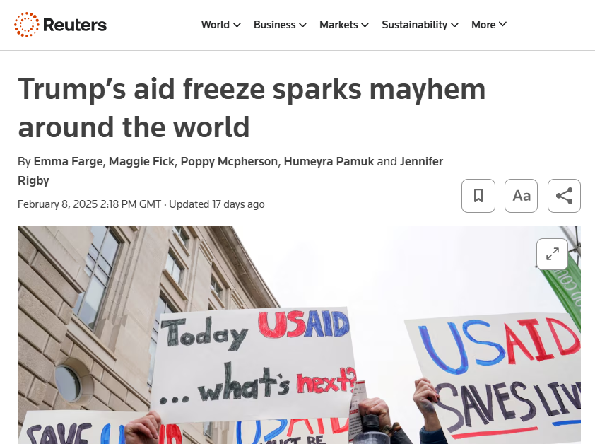
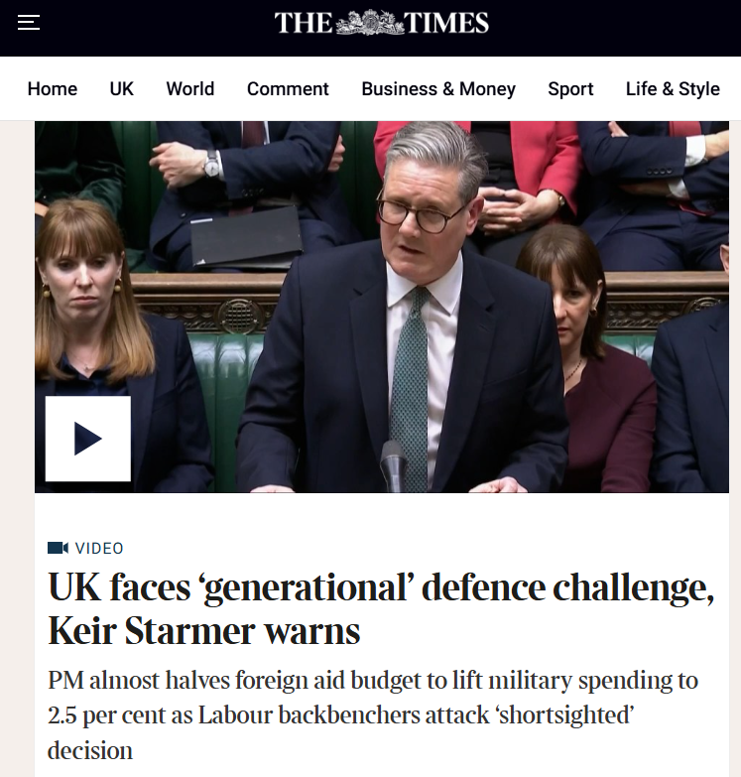
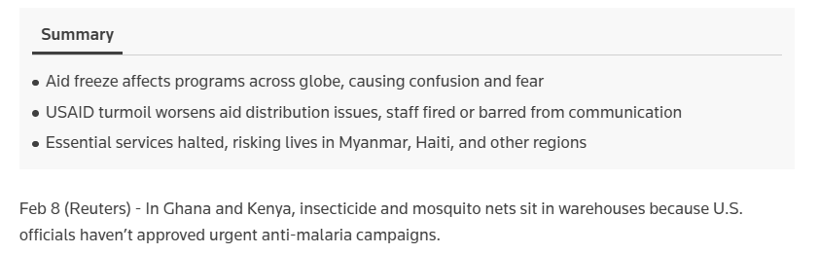

Slide 6
What is health economic evaluation?
Comparison of the additional costs relative to the additional health benefits of one intervention vs. a comparator intervention
  Note: A product – a vaccine, a tablet – is not an intervention!
  An intervention requires action by humans – and a clear definition of who, what, where, when, why, for how long, how often, etc.
“Cost-effectiveness” is judged based on opportunity costs – what else could have been achieved with those same resources?
  Often involves comparison against a cost-effectiveness threshold
Not an accounting exercise!
  “financial costs” = money → important for budgeting
  “economic costs” = value of resources → important for guiding choices

Slide 7
Outline
Key principles of cost-effectiveness
SMC
PMC
Malaria vaccines
Conclusions

Slide 8
Cost and cost-effectiveness of
extending SMC to
5 monthly cycles or to children under 10 years in Guinea, Niger & Mali
David Bath, Halimatou Diawara, Catherine Pitt, Paul Milligan
& many others!

Slide 9
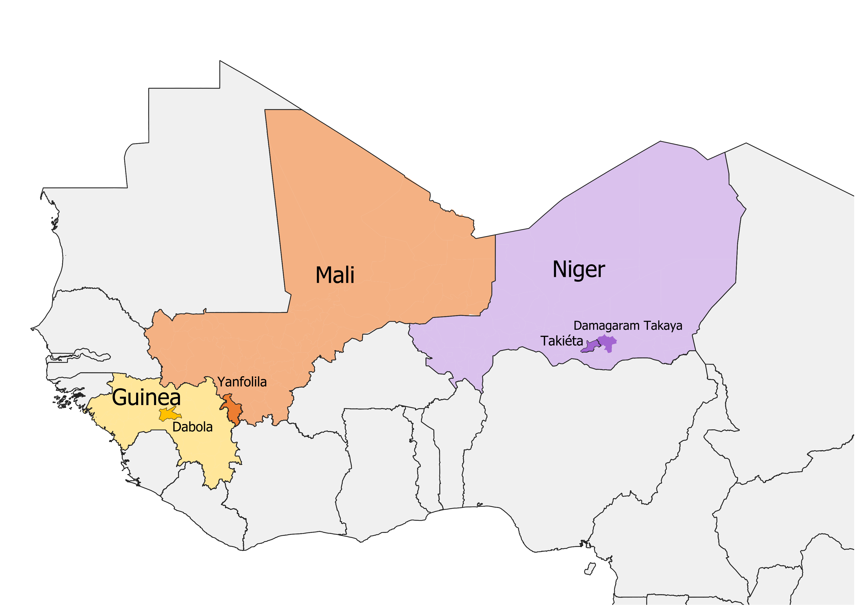
The SMC Impact project
NMPs in Guinea, Mali & Niger piloted SMC extensions in 4 districts
Adding a 5th cycle in children <5y (1 district per country)
Adding a 5th cycle in children <10y (1 additional district in Niger)
This presentation will cover:
Adding a 5th cycle
  Costs
  Impact
  Cost-effectiveness
Extending to <10y
  Costs
  Impact
  Cost-effectiveness

Slide 10
Methods for Costing of SMC strategies
Detailed, prospective, activity-based costing of resources used to deliver 5 SMC cycles in 2022 season
Identified SMC activities through qualitative research and consultation with NMCP staff
  Resources identified at national / district / health facility levels
  Financial & economic costs
Estimated in constant 2022 USD
  Cost of 5 cycles (observed)
  Cost of 4 cycles (estimated)

Slide 11
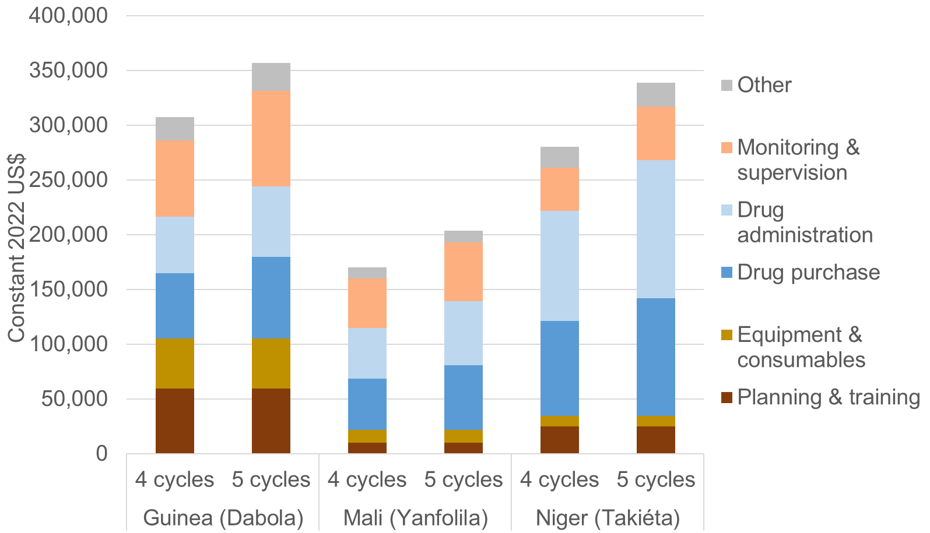
Adding a 5th cycle increased total annual economic cost of implementing SMC by 16% to 23%
+16%
+21%
+23%
* SMC programme costs only; excludes diagnosis & treatment costs
Notes:
Figure and Mali %increase label updated.

Slide 12
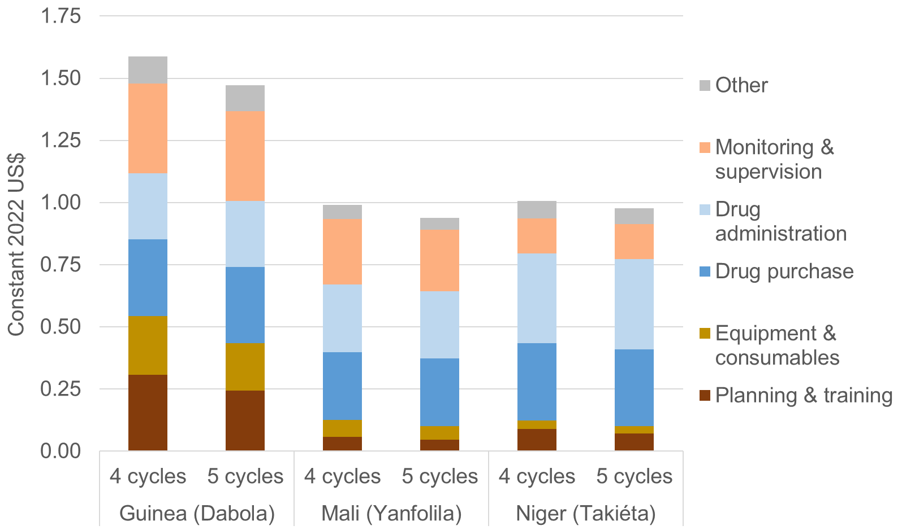
Adding a 5th cycle decreased the economic cost per child per cycle by 3% to 7%
-7%
-3%
-5%
* SMC programme costs only; excludes diagnosis & treatment costs
Notes:
Note that “per child per cycle” is the same as “per dose”.

Slide 13
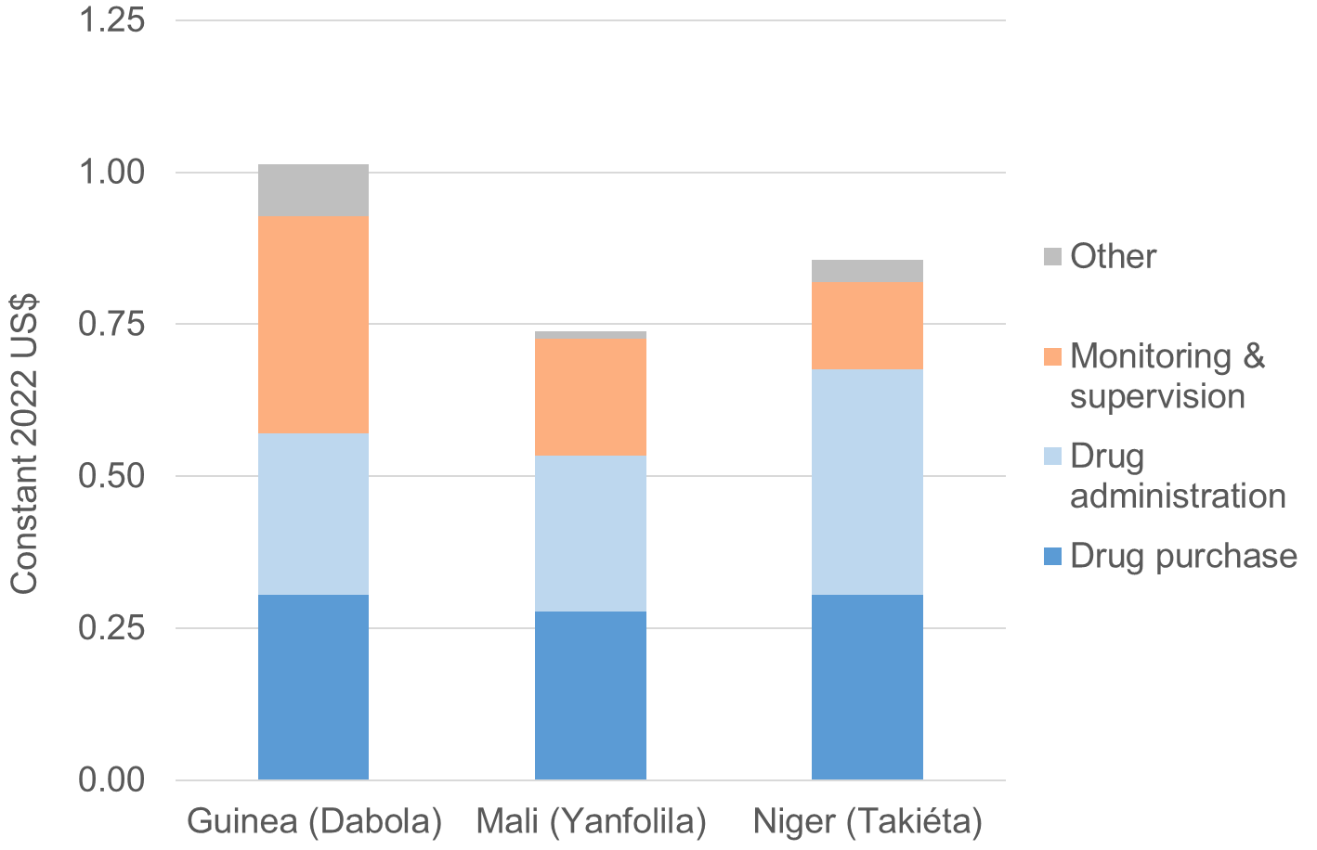
Adding a 5th cycle cost an additional
$0.74 to $1.01 per child reached
$1.01
$0.86
$0.74
* SMC programme costs only; excludes diagnosis & treatment costs
Notes:
Note that “per child per cycle” is the same as “per dose”.

Slide 14
Methods for estimating impact
Monthly incidence for each district obtained:
  with 5 SMC cycles – DHIS2 data (what happened)
  with 4 or 0 SMC cycles – modelled (hypothetical counterfactual)
Malaria cases averted by SMC each week estimated based on:
  number of children receiving SMC per cycle
  SMC efficacy (0-28 days; 29-42 days)
  probability that SMC recipient would have had malaria based on incidence and seasonality
Seasonality profile by week (% annual cases) based on health facility data on cases in >5y
Estimated disability-adjusted life-years (DALYs) based on:
  cases averted by SMC
  secondary data (progression to severe disease & death, life expectancy, disability weights)
Identified optimal start dates to maximise the effectiveness of each strategy

Slide 15
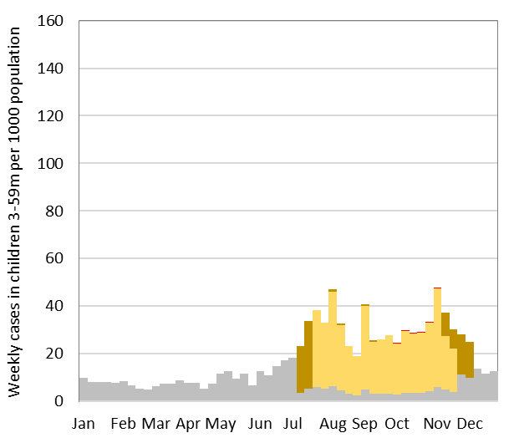
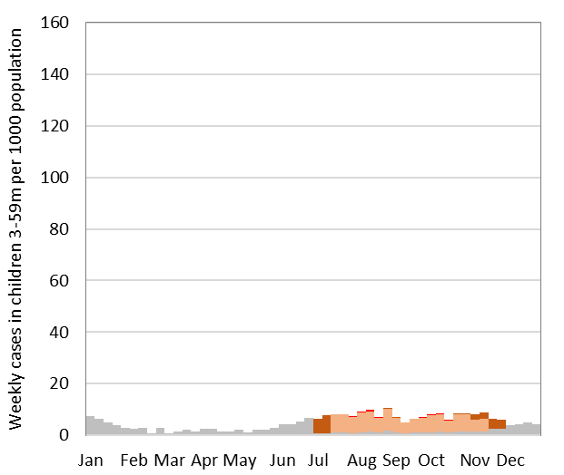
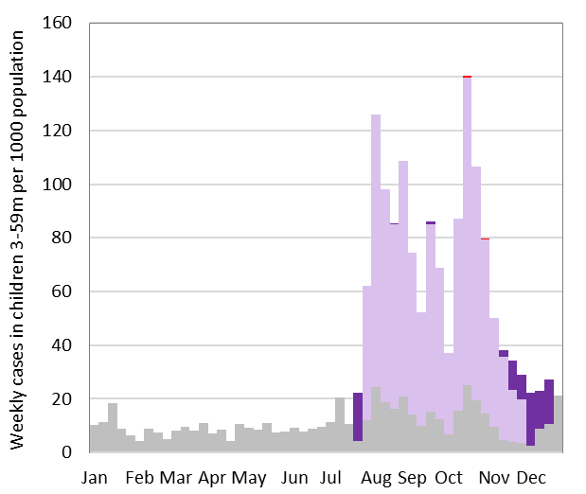
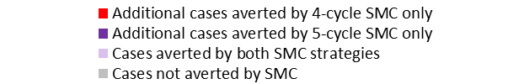
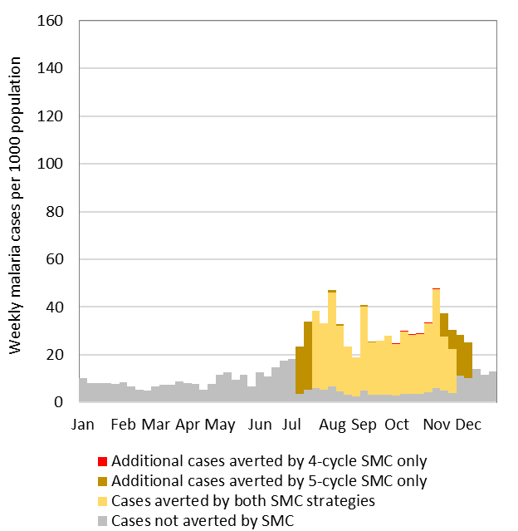
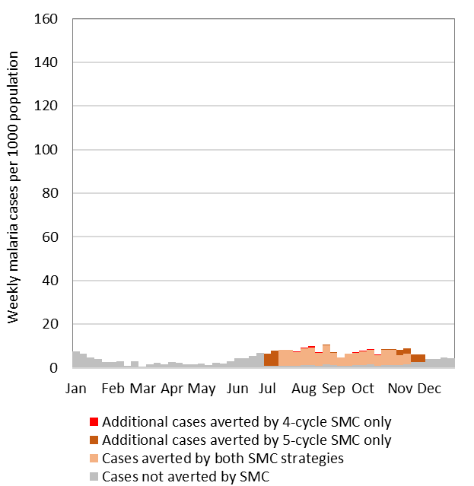
SMC averts a substantial proportion of cases
Dabola (Guinea)
Yanfolila (Mali)
Takiéta (Niger)
Notes:
Figures updated

Slide 16
Not implementing any SMC would result dramatic epidemics in some areas
Dabola (Guinea)
Yanfolila (Mali)
Takiéta (Niger)
Notes:
Figures updated

Slide 17
SMC averts more cases when delivered in high incidence periods
Dabola (Guinea)
Yanfolila (Mali)
Takiéta (Niger)
Without SMC
Without SMC
Without SMC
974 annual cases / 1000 pop.
267 annual cases / 1000 pop.
1,751 annual cases / 1000 pop.
11% annual cases in 5th cycle
10% annual cases in 5th cycle
5% annual cases in 5th cycle
107 cases / 1000 pop. in 5th month
27 cases / 1000 pop. in 5th month
88 cases / 1000 pop. in 5th month
Notes:
Figures updated

Slide 18
Methods for cost-effectiveness analysis
Incremental cost-effectiveness ratio (ICER):
  the additional cost of switching from 4 cycle to 5 cycle SMC strategy
  expressed as: incremental cost per DALY averted
  Includes cost savings from reduced diagnosis & treatment*
ICER compared to cost-effectiveness thresholds
  % (Ochalek et al, 2018) x per capita GDP (World Bank, 2022)
    Guinea: 21-27% x $1,417 = $297 - $382 per DALY averted
    Mali: 10-13% x $814 = $81 - $106 per DALY averted
    Niger: 25-33% x $610 = $152 - $201 per DALY averted
  Median across 18 SMC countries: $191 - $251 per DALY averted
Deterministic & probabilistic sensitivity analyses
  Including alternative admin vs. survey coverage estimates
* WHO-CHOICE: Stenberg K et al. Cost Eff Resour Alloc 16, 11 (2018)

Slide 19
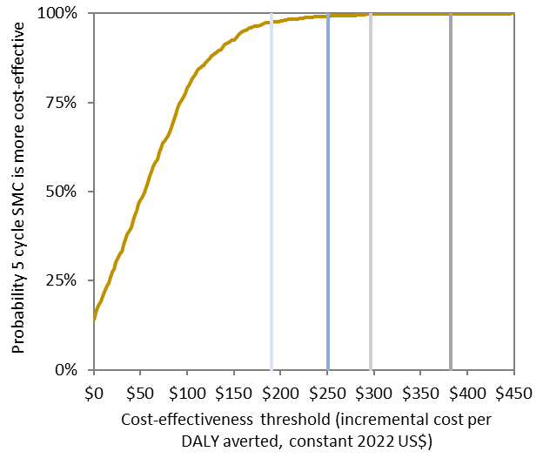
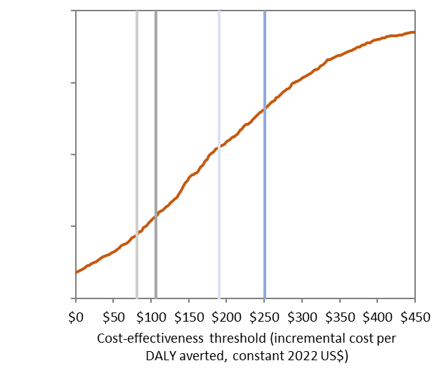
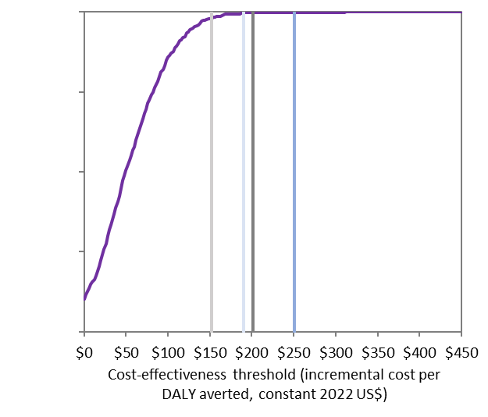

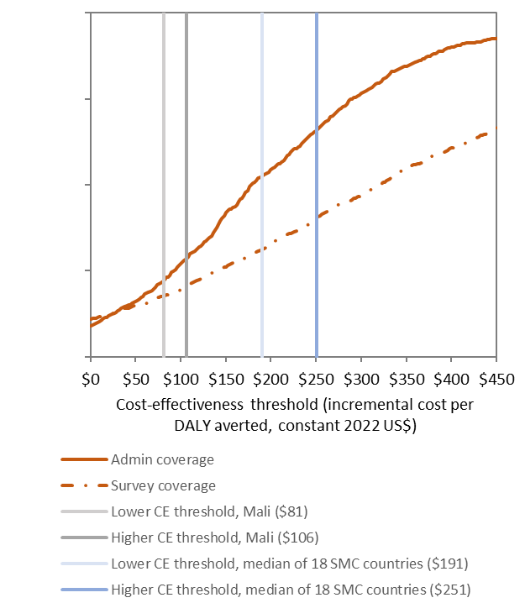
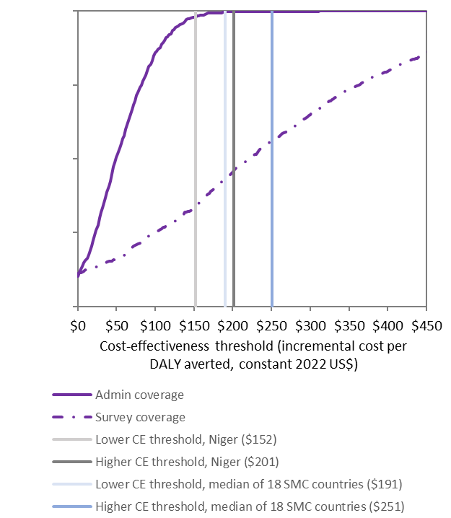
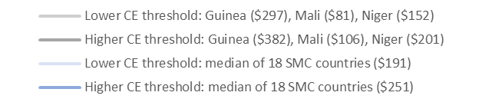
A 5th cycle appears cost-effective in Dabola & Takiéta
(based on administrative coverage) because incidence in 5th month was high
Dabola (Guinea)
Yanfolila (Mali)
Takiéta (Niger)
Very cost-effective (>99% prob.)
Not
cost-effective (<28% prob.)
Very cost-effective (>99% prob.)
Notes:
Figures updated.
GDP per capita (2022 US$) [Source: World Bank (https://databank.worldbank.org/indicator/NY.GDP.PCAP.CD/1ff4a498/Popular-Indicators)]:
Guinea: $1416.6
Mali: $814
Niger: $610
Low-high CE thresholds (% GDP per capita) [Source: Ochalek et al 2018]:
Guinea: 21-27%
Mali: 10-13%
Niger: 25-33%

Slide 20
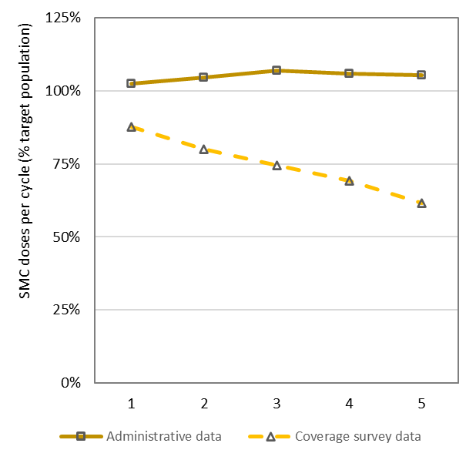
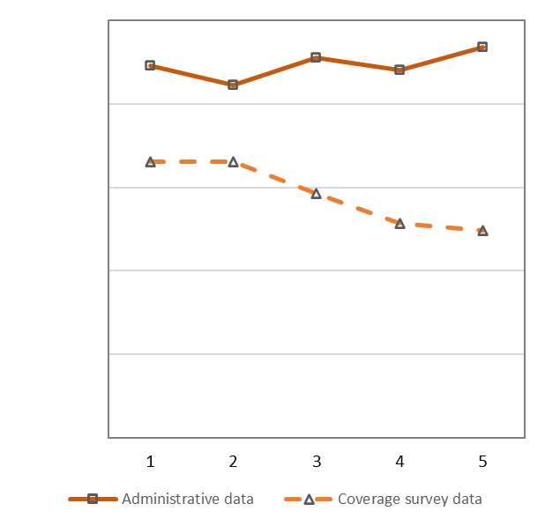
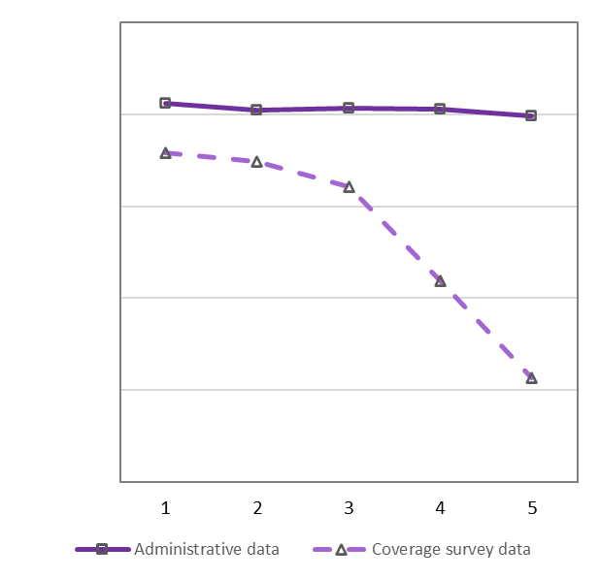
Surveys indicate lower coverage than administrative data
Dabola (Guinea)
Yanfolila (Mali)
Takiéta (Niger)
Notes:
Figures updated

Slide 21
Adding a 5th cycle remains cost-effective in Dabola when using survey coverage estimates but no longer cost-effective in Takiéta
Dabola (Guinea)
Yanfolila (Mali)
Takiéta (Niger)
Very cost-effective (>99% prob.)
Very cost-effective (>92% prob.)
Not
cost-effective (<20% prob.)
Borderline
cost-effective (<46% prob.)
Notes:
Figures updated

Slide 22
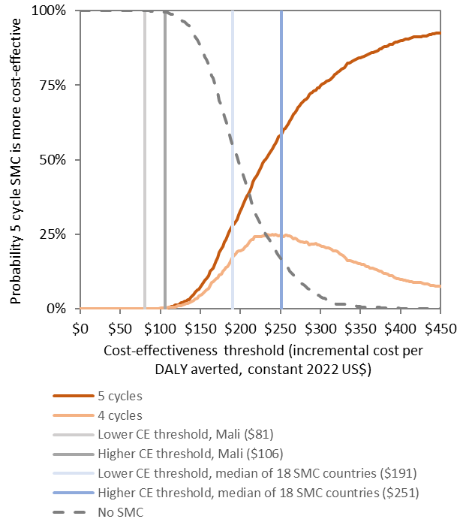
In Yanfolila, even a 4-cycle strategy does not appear cost-effective
Notes:
Additional slide

Slide 23
Methods for evaluating extension to <10y
Costs collected prospectively in Damagaram Takaya (Niger) in 2022:
  5 cycles in <10y
Costs modelled by assessing the fixed/variable nature of costs for each activity for:
  5 cycles in <5y
  4 cycles in <10y
  4 cycles in <10y
Similar to previous approaches to modeling impact and cost-effectiveness

Slide 24
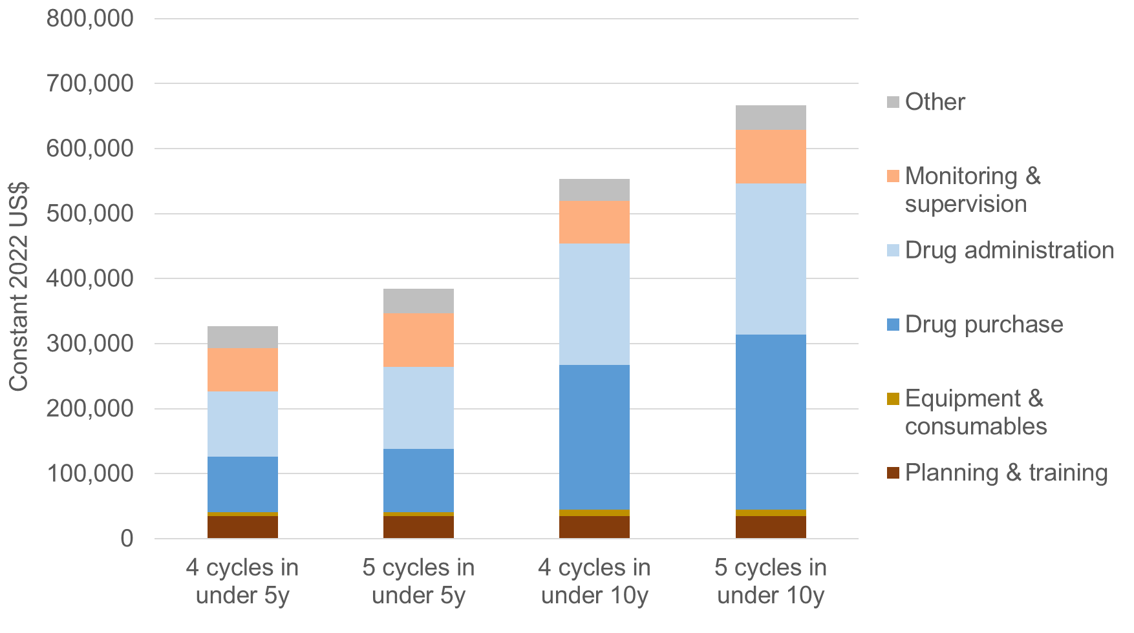
Annual economic cost of alternative SMC strategies
+100%
+21%
+65%
+40%
+18%
Preliminary results
* SMC programme costs only; excludes diagnosis & treatment costs

Slide 25
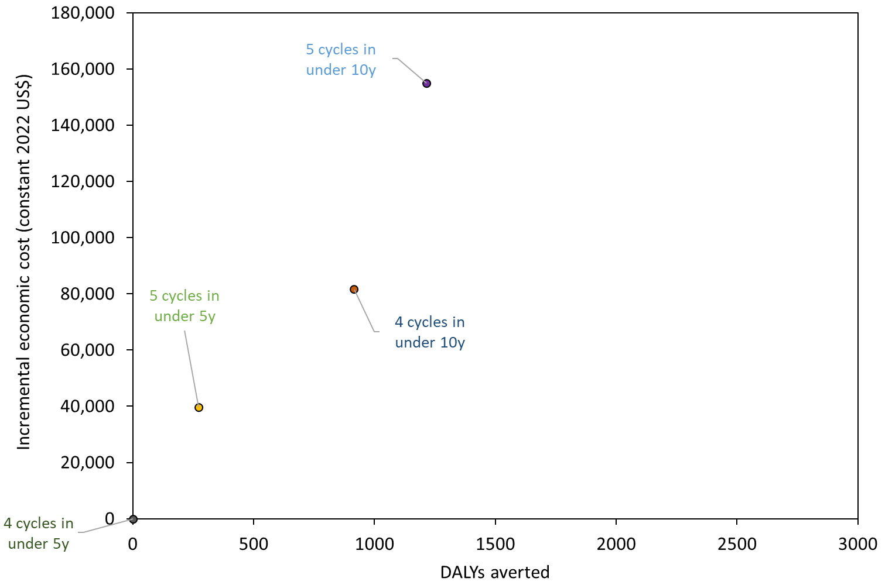
Extending to <10y appears cost-effective in DKT
(based on survey coverage)
5 cycles in <10y
Niger cost-effectiveness threshold:
$133 to $176
per DALY averted
Not cost-effective
$246 per DALY averted
5 cycles in <5y
4 cycles in <10y
$89 per DALY averted
4 cycles in <5y
Preliminary results

Slide 26
Key insights – SMC
Costs of SMC
  Variation across contexts and with implementation choices
  Only 19%-32% is cost of SP+AQ – the rest is in-country delivery
  4 cycles for <5y cost ~$1 - $1.60 per child per cycle; additional $0.74 - $1.01
  Economies of scope: Cost per child per cycle are lower when extending to <10y and/or a 5th cycle because of fixed costs
Cost-effectiveness
  Standard SMC (4 cycles for <5y) is not cost-effective everywhere that it is currently implemented (Yanfolila – low incidence)
  Adding a 5th monthly cycle may be cost-effective where high incidence and coverage in 5th month → NOT about % of annual incidence
  Extending to <10y in DKT (Niger) appeared cost-effective, but cost +65%
  Conclusions sensitive to uncertainty in coverage, CFRs, other parameters
Notes:
Estimates of cases with/without SMC are relatively reliable (I think?): DHIS2 data on cases with SMC; good data on SMC efficacy to estimate cases averted by SMC. But DALYs (and health service costs) are very sensitive to assumptions of progression to severe malaria and death; reliable data on these parameters are limited, particularly at this geographic level.
Our assumptions (for children <5y) are taken from analysis Matt Cairns did, published (I think) in Gilmartin C et al. Seasonal malaria chemoprevention in the Sahel subregion of Africa: a cost-effectiveness and cost-savings analysis. Lancet Glob Health 2021; 9(2): e199-e208. I used 2016 country-level estimates (Guinea, Mali, Niger) of cases, severe cases, and deaths (per month) to calculate the % progression to severe, and CFR of a severe case:
% progression from uncomplicated to severe: Guinea 2.1%, Mali 2.4%, Niger 2.3%.
CFR of severe cases: 22.4% (all 3 countries/districts).
For the under 10y analysis (later slides), I just assumed (for now) a CFR for severe malaria in children 5-9y of 10% (rather than 22.4%); I assumed the progression to severe would be the same as for children <5y.

Slide 27












Malaria Research & Training Center,
University of Bamako, Mali
Halimatou Diawara, Seydou Traore,
Ibrahim Diarra, Issaka Sagara, Alassane Dicko
London School of Hygiene & Tropical
Medicine, UK
David Bath, Catherine Pitt, Paul Milligan,
Paul Snell
Mafereniyah Research Institute, Guinea
Bienvenu Camara
Universite Gamal Abdel Nasser, Guinea
Kovana M Loua, Jonas Loua
Programme National de Lutte contre
le Paludisme, Guinea
Eugene K Lama
Programme National de Lutte contre
le Paludisme, Mali
Idrissa Cisse
Université Abdou Moumouni
de Niamey, Niger
Eric Adehosi, Ibrahim Alkassoum
University of Zinder, Niger
Mahaman Moustapha Lamine
Programme National de Lutte contre
le Paludisme, Niger
Abou Yahaya, Hadiza Jackou
Catholic Relief Services
Chrestien Yemeni, Suzanne Van Hulle, Joel Sodjinou, Agamaraki Adamou, Kano Assane
Medicines for Malaria Venture
Germaine Ekoyol, Andre Marie Tchouatieu
THANK
YOU

Slide 28
Outline
Key principles of cost-effectiveness
SMC
PMC
Malaria vaccines
Conclusions

Slide 29

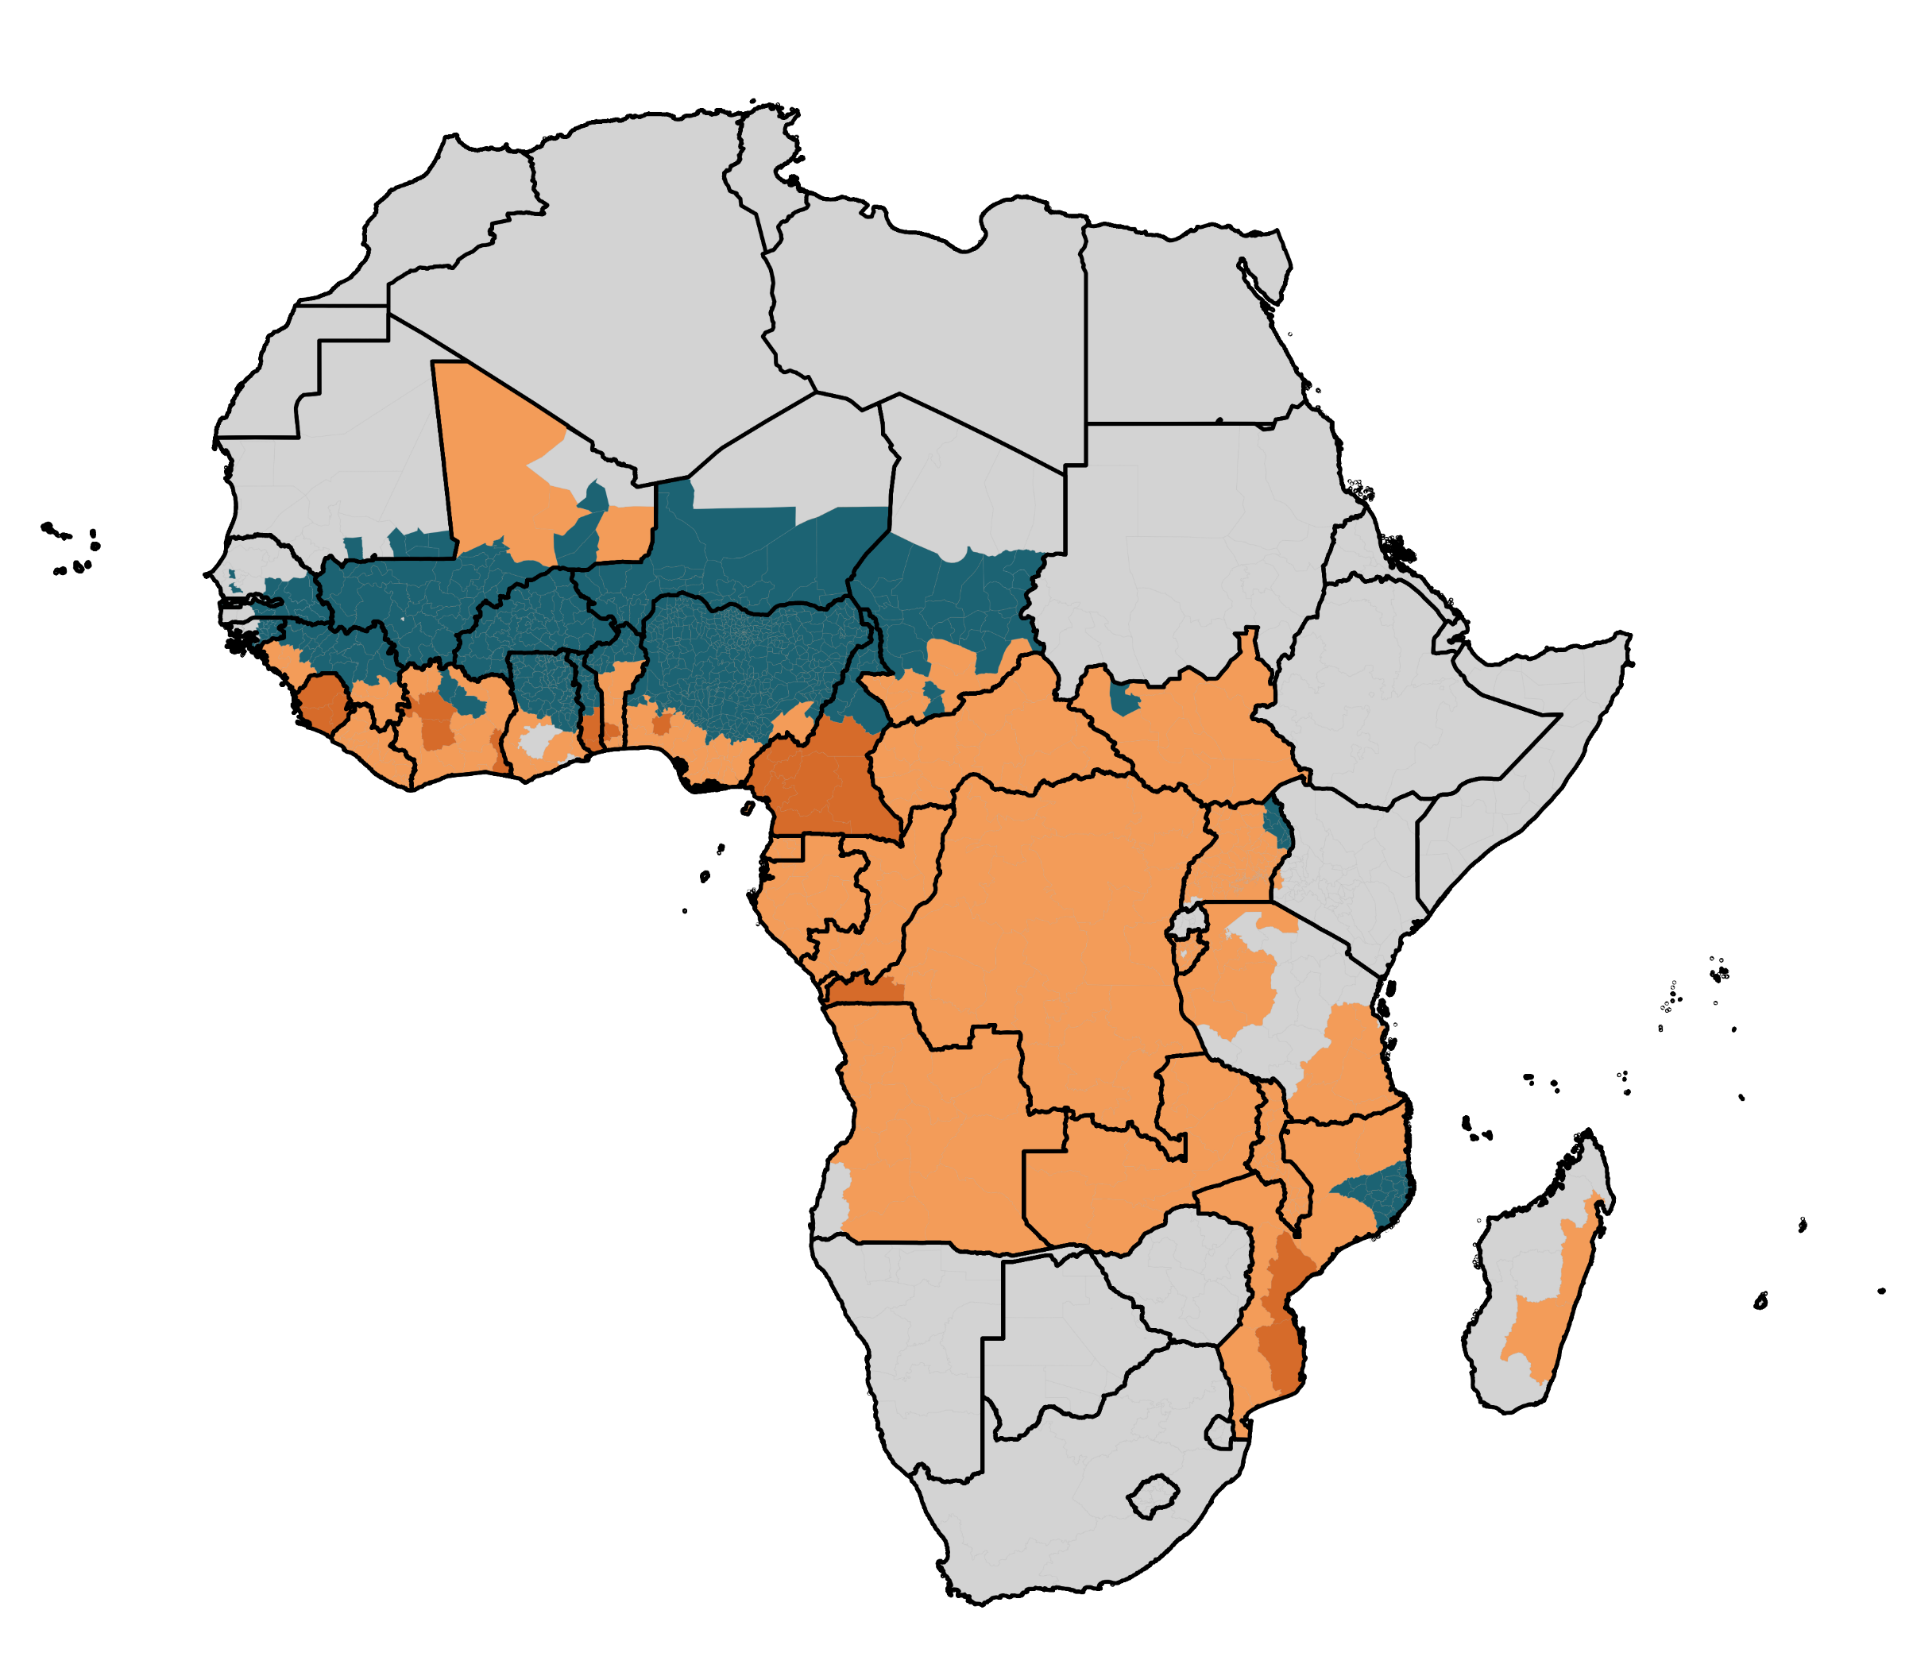

PMC
Economic Evaluation &
PMC Decision Tool

Slide 30
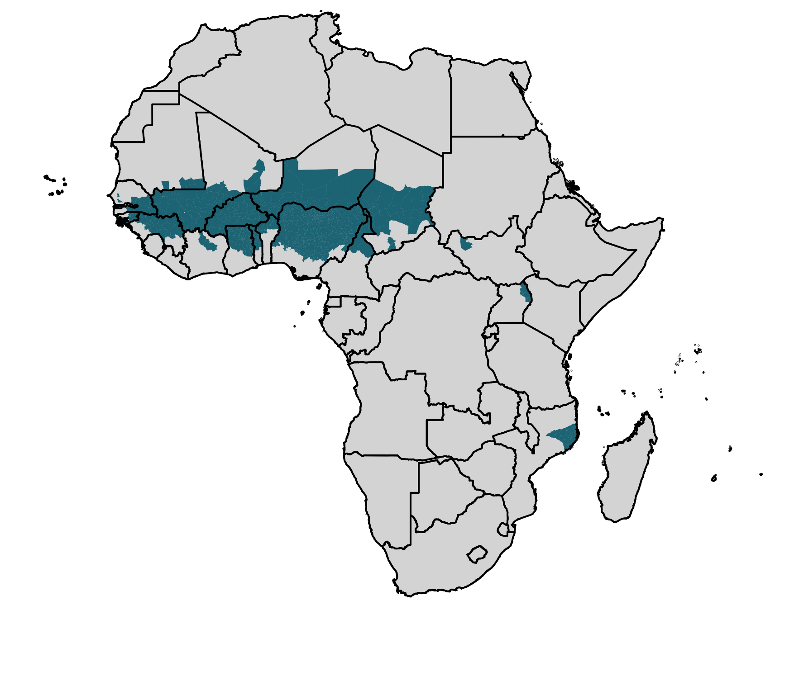

20 million children under 2 years old live in admin-1 regions where SMC was implemented in 2023
SMC implemented in 2023

Slide 31
39 million children under 2 years old in 25 countries live in admin-1 areas of moderate to high transmission without SMC
Of these, <4 million live in admin-1 areas with any PMC implementation
SMC implemented in 2023
PMC implemented in 2023
Moderate/High Transmission (≥0.10% PfPR2-10)
>35 million children may be eligible for PMC but lack access

Slide 32
PMC costs much less per child than SMC
PMC: lower costs of medicines (SP vs. SP+AQ) and delivery (routine vs. campaign)
WHO stratification approach distinguishes SMC-eligible vs. PMC-eligible areas
Most “SMC countries” have PMC-eligible areas
The same national budget could protect far more children (different geographies / children within the country) with PMC than SMC
Consider “routine” (“light”?) versions of SMC to reduce costs (and coverage)
 | Efficacy: Days 1-28 | Efficacy: Days 29-42 (not relevant if doses given 28 days apart) | Cost per course per child
SMC with SP+AQ | 88% (95% CI: 79-94%) | 61% (95% CI: 47-72%) | ~$1 - $1.60 ?
PMC with SP | 59% - 92% (variation across Plus Project supported districts) | 8% - 32% (variation across Plus Project supported districts) | ~$0.20 - $0.50 ?
Cairns M et al. Effectiveness of seasonal malaria chemoprevention (SMC) treatments when SMC is implemented at scale: case–control studies in 5 countries. PLOS Med 18.9 (2021): e1003727
Mousa et al. Estimating the impact of dhps mutations on Sulfadoxine-Pyrimethamine protective efficacy: evidence from therapeutic effica*Mousa, A, cy studies and implications for malaria chemoprevention in sub-Saharan Africa. In review. https://dx.doi.org/10.2139/ssrn.4856036
Notes:
Acknowledgement: Plus Project Economic Evaluation Work Package. These figures are based on the following approach/sources of data:
Assume each intervention involves 4 doses/rounds per year i.e. full coverage is achieved at the same cost for each dose.
Cost per dose of dispersible SP for PMC is from Plus Project procurement records, taking an average cost across an 8-dose schedule (age-based dosing; 4 doses to children <12 months & 4 doses to children >=12 months) and multiplying by 4. Includes freight, insurance, in-country testing and 10% wastage.
Data on other financial and economic costs per dose of PMC from Manzi et al. 2008 (https://bmchealthservres.biomedcentral.com/articles/10.1186/1472-6963-8-165), adjusted for inflation from 2005 USD to 2023 USD. Will be updated with outputs of the Plus Project economic evaluation in due course.
Data on the costs of SMC from Gilmartin et al. 2021 (https://www.thelancet.com/journals/langlo/article/PIIS2214-109X(20)30475-7/fulltext), taking the average across six countries of the reported annual cost per child per year (adjusted for inflation from 2016 USD to 2023 USD).

Slide 33
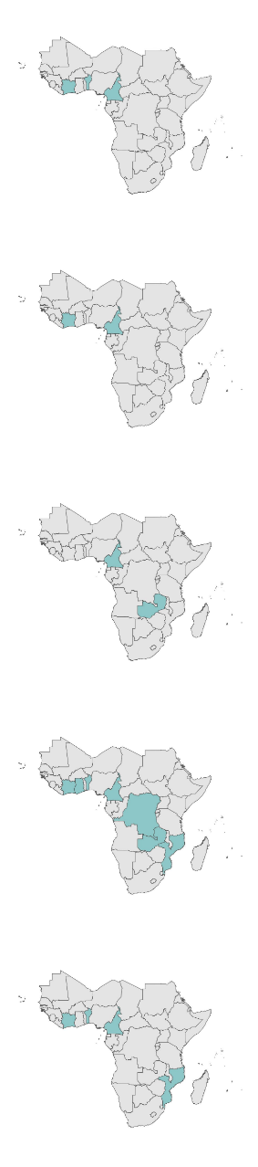
A tailored evaluation approach
4 countries
(BEN, CDI, CMR, MOZ)
Process evaluation
2 countries
(CDI, CMR)
Impact evaluation
PMC Decision tool
2 countries
(CMR, ZAM)
Parasite Clearance and Prevention of Infection
25 countries with
PMC-eligible
children
7 countries
(BEN, CDI, CMR, DRC, GHA, MOZ, ZAM)
Genotype mapping
4 countries
(BEN, CDI, CMR, MOZ)
Economic evaluation

Slide 34
Process evaluation
PMC coverage
Secondary data
PMC Decision tool
Impact evaluation
PMC efficacy
PMC effectiveness
Malaria incidence
EPI coverage
VitA coverage
Malaria treatment coverage
Price levels
Population
etc.
PCPI
Parasite Clearance and Prevention of Infection
Variation in SP efficacy against infection with parasite genotype
Genotype mapping
Parasite genotype maps
Economic evaluation
Cost per dose of PMC delivered
Cost savings per case of malaria avoided

Slide 35
PMC Decision Tool Outputs
Costs, effects, and cost-effectiveness
  for each admin-1 area
Modelled for alternative PMC schedules and delivery models
  using the Imperial malaria simulation model
Incorporating variation in:
  SP protective efficacy based on local genotype profiles
  Expected coverage of each target PMC dose
  Costs and cost savings from averting malaria cases
  Potential impact of PMC in addition to existing core control measures
    with/without RTS,S or R21
Presented:
  in an interactive web-based tool
  with a ranked prioritisation according to cost-effectiveness → FLEXIBILITY & IMPACT

Slide 36
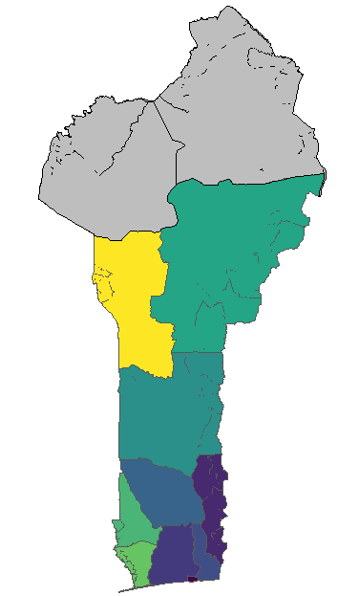
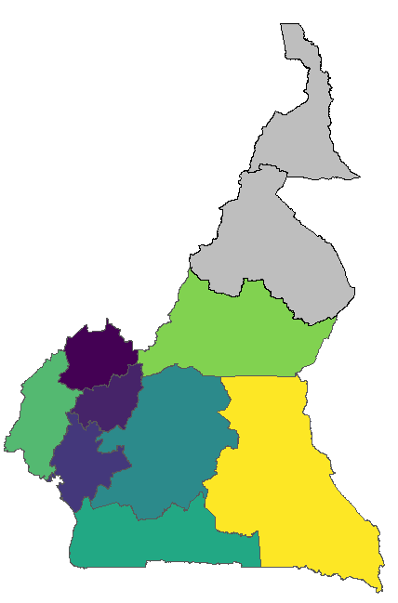
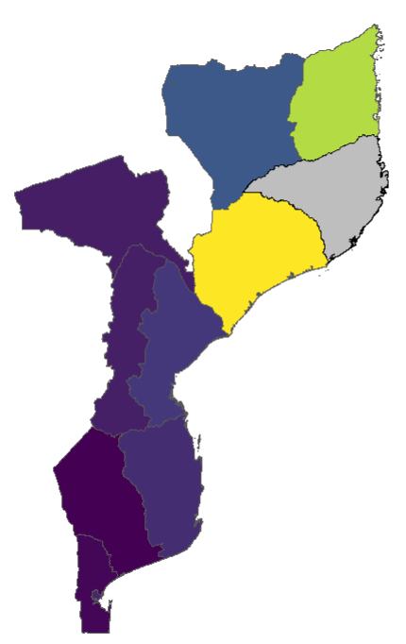
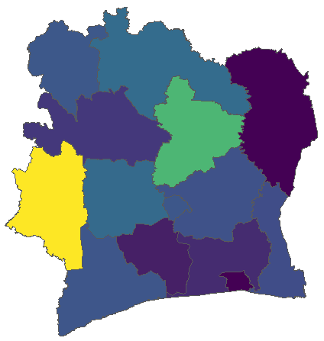
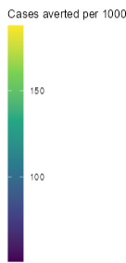
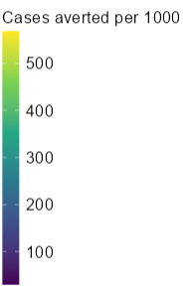
PRELIMINARY RESULTS
Reduction in malaria cases:
Country-specific PMC model vs. No PMC
Clinical cases averted
(per 1000 children aged 0-2.5 years per year)
120
200
150
249
200
276
166
60
100
100
100
187
Côte d’Ivoire
(5 course)
Benin
(8 course)
Cameroon
(8 course)
Mozambique
(5 course)
using modelled genotype frequency predictions due to small sample denominators (Foo & Flegg J R Soc Interface. 2024;21(210):20230570)
Notes:
Results from the modelling will be presented in the decision tool app, which will be hosted and used like a website
Some preliminary results are shown here in the app for Cameroon for the 8-dose delivery schedule using our estimated coverage levels from the modelling work
PMC impact is driven by SP efficacy, PMC coverage and transmission intensity
The map shows the spatial variation in the predicted % reduction in clinical cases and predicted annual number of cases averted per 1000 during PMC delivery
We see the highest potential impact from PMC in the East with an estimated 187 number of cases averted per 1000 annually in the age group 0-2.5 years old
This is because in Est we see a lower frequency of SP resistant haplotypes, so there is a higher duration of protection following SP administration
Our modelling results also show little evidence of high rebound rates under current coverage estimates

Slide 37
Ranking priorities by cost-effectiveness
Ranked choice list
  Starts with the single most cost-effective choice of delivery schedule and region
  Next, an additional choice to add on top if additional funding is available
    Should we intensify the delivery schedule in the same region OR expand PMC to another region?
For each ranked option:
  Health impact
  Incremental and cumulative programmatic cost of PMC
  Incremental cost-effectiveness ratio (economic costs, including savings from case reductions)
=
Notes:
Our next steps include presenting results on the costs and cost-effectiveness of different delivery schedules in the decision tool app
Here we show what these results will look like, and includes a ranked list of PMC delivery schedules based on their cost-effectiveness
This list can be used in conjunction with other sources to guide which regions PMC should be prioritized in, and which delivery schedules will be most cost effective
In the current example table showed in the app, it recommends prioritizing delivery schedule B in region 1 first, before prioritizing delivery schedule D in region 1, then delivery schedule E in region 2 and so forth

Slide 38
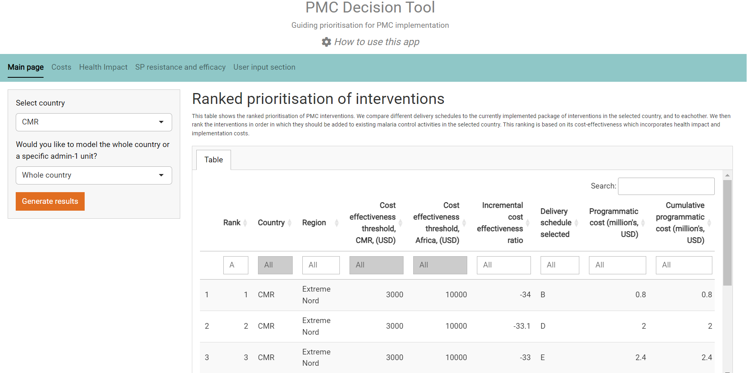
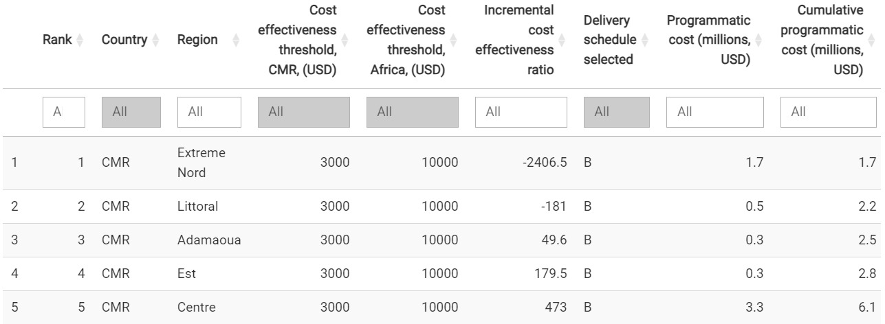
Country 1
Country
Region 1
Region 1
Region 1
Country 1
Region 2
Country 1
Region 2
A
Region 3
Country 1
Region 3
C
Country 1
Region 2
Country 1
Region 1
=
Notes:
Our next steps include presenting results on the costs and cost-effectiveness of different delivery schedules in the decision tool app
Here we show what these results will look like, and includes a ranked list of PMC delivery schedules based on their cost-effectiveness
This list can be used in conjunction with other sources to guide which regions PMC should be prioritized in, and which delivery schedules will be most cost effective
In the current example table showed in the app, it recommends prioritizing delivery schedule B in region 1 first, before prioritizing delivery schedule D in region 1, then delivery schedule E in region 2 and so forth

Slide 39

Key insights - PMC
PMC is lower cost, lower coverage than SMC – unless SMC becomes more “routine”
Huge heterogeneity across contexts
Many options for PMC delivery models (number, timing, mode)
A ranked prioritization gives flexibility to respond to changing resource envelope without additional modelling
PMC Decision Tool serves as an example for how multi-intervention models could be structured
=

Slide 40
This work is a collaboration between researchers, implementers, national programmes, and other stakeholders
The views expressed is this presentation are of the research team.
Particular thanks to
Ishana Atkinson & Andria Mousa
for their work in modelling and preparing this presentation,
and to Junior Voundi, Lucy Okell, Peter Winskill, Alba McGirr, and Ludovica Ghilardi
for their contributions
=

Slide 41
Outline
Key principles of cost-effectiveness
SMC
PMC
Malaria vaccines
Conclusions

Slide 42
Optimising the impact of malaria vaccines
in West and Central Africa

Slide 43
Overall project purpose
To collaborate with national immunisation and malaria programmes in 14 countries to undertake implementation research to:
Optimise delivery and uptake of malaria vaccines in contexts of seasonal transmission
Exploit the opportunities of malaria vaccine introduction to strengthen delivery of other vaccines and health interventions

Slide 44

Example research question
Are malaria vaccines cost-effective?
Would it be cost-effective to implement
this strategy to optimize malaria vaccine coverage
compared with
a “standard” strategy for malaria vaccine implementation
OR no malaria vaccination
in xxx context and for xxx population group?
Alternatively: Are any added health benefits worth any added costs?
→Taking into account what else you might have done with those extra resources

Slide 45
Example research question
Are malaria vaccines cost-effective?
Would it be cost-effective to implement
seasonal intensification
to optimize malaria vaccine coverage
at the time of greatest risk and exploiting opportunities for integration
compared with
an age-based strategy for malaria vaccine implementation
in northern Benin for children under 3y?

Slide 46
More economic research questions . . .
What are the extra costs of implementing the optimisation strategy?
    This requires identifying the intervention and comparator: who, what, where, when, why, how, for how long, for how often*
    Additional meetings, training, fuel, vehicles, per diems, radio spots, materials, etc.
    Additional vaccine doses?
How many malaria cases and deaths are averted by optimised vs. standard MVAC?
    From higher coverage
    From better-timed coverage in the year
    From better targeted coverage by age
    From better targeted coverage by geography / population group?
What health gains arise from improved coverage of co-delivered interventions?
    SMC, other vaccines, vitamin A, deworming, growth monitoring, care-seeking for fever . . . ?
What are the cost savings from reduced need for diagnosis and treatment?
  *Hoffman et al (2014). Better reporting of interventions; template for intervention description and replication (TIDieR) checklist and guide. BMJ.

Slide 47
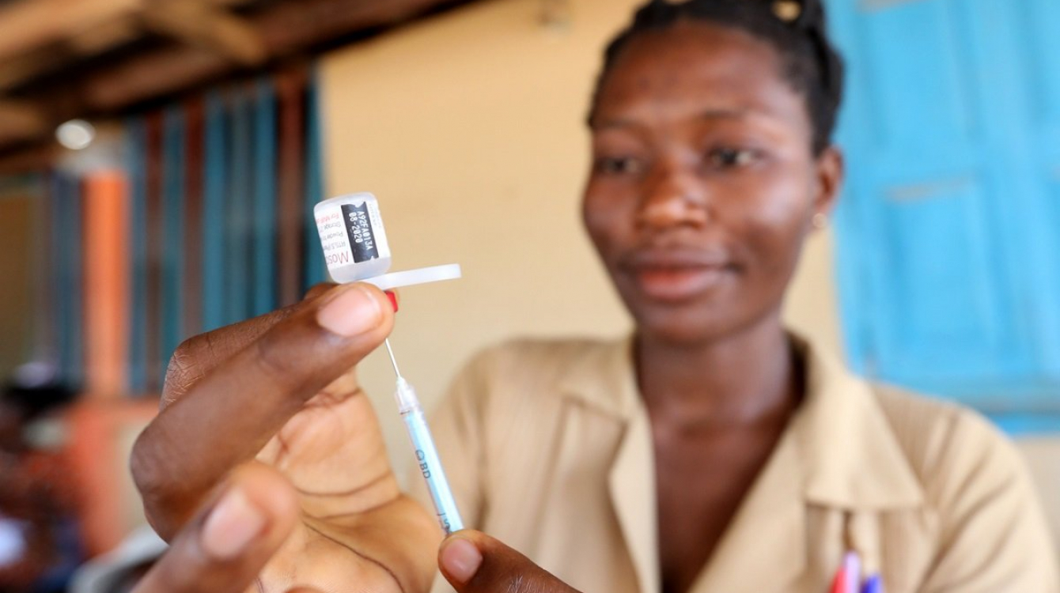
. . . and also
5. How do our findings about costs and cost-effectiveness vary across contexts?
6. What lessons and recommendations can programmes draw?
World Health Organization
These economic research questions are examples
to be refined and developed collaboratively

Slide 49
Outline
Key principles of cost-effectiveness
SMC
PMC
Malaria vaccines
Conclusions

Slide 50
Conclusion - Insights for action now
Make the case for urgent investment in malaria
  to MOF, private sector, and (new / non-traditional) donors
  Focus on costs (investments + savings) and deaths (or DALYs) – not just cases
Prioritise to maximise health impact and minimise deaths – equity & efficiency
  Geographical areas – with highest (malaria) mortality rates
  Population groups – with highest (malaria) mortality rates
  Interventions – with highest effectiveness against deaths for the cost
De-prioritise to free up resources for more cost-effective uses
  Many activities will stop this year – opportunity to choose consciously
Implement efficiently
  Integrate interventions if efficient (and not adding inefficient complexity)
  Flexible mentality needed – not business-as-usual
  Accept <100% coverage – prevent epidemics overwhelming health services

Slide 51
Merci
Akpe
Thank you
Obrigada

