Slide 1
Evidence Gaps in Assessing the Economic Implications of Malaria Prevention Interventions
Justice Nonvignon, PhD
Technical Director, PHC Efficiency & Effectiveness
jnonvignon@msh.org
SMC Alliance Meeting, February 28, 2025, Lome
Photo credit: Timothé Chevaux/MSH

Slide 2
Session Objectives & Agenda
Objectives:
Present summary of the evidence on SMC delivery efficiency (costs and cost-effectiveness).
Facilitate discussion on the alignment of these findings with the current needs and challenges faced by National Malaria Control Program Managers.
Agenda:
Presentation of Key Findings
Discussion of NMCP health economics evidence needs

Slide 3
Importance of Health Economics for SMC
Informed planning and budgeting: supports strategic allocation of limited resources, ensuring funding is directed toward high-impact areas.
Resource prioritization and benchmarking: In the context of resource constraints, provides benchmarks to assess efficiency and effectiveness, guiding investment decisions.
Evidence for scale-Up and integration: generates data to support expanding SMC programs and integrating them with other health and development interventions.
Cost-effectiveness comparisons: Enables comparison of alternative interventions or delivery options to optimize use of resources.
Sustainable financing strategies: strengthens the investment case by demonstrating long-term financial and societal returns from SMC programs.

Slide 4
Summary of Evidence

Slide 5
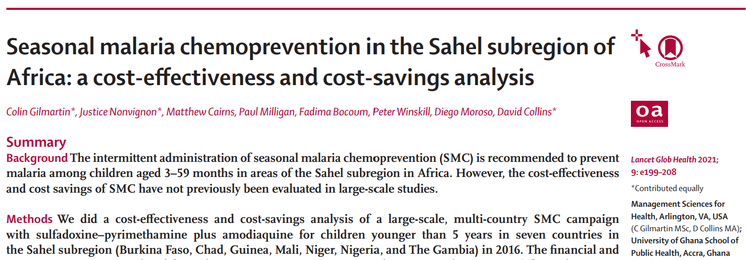
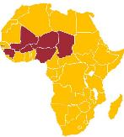
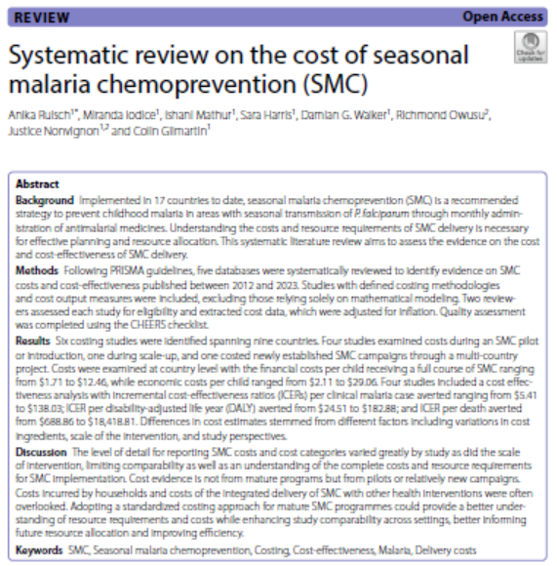
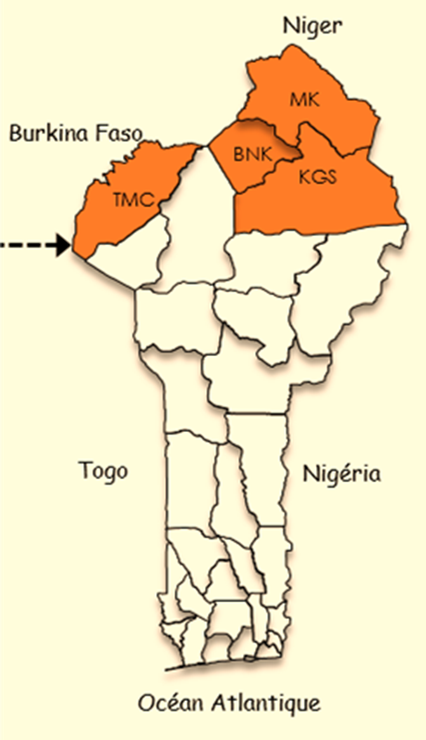
Landscape of SMC economics studies (MSH/UG)
Estimating the opportunity cost of seasonal malaria chemoprevention implementation in Burkina Faso, Mali and Senegal

Slide 6
SMC Costing Systematic Review Findings (2024)
Table 1. Summary of studies identified by the systematic review.
Publication | Year of SMC campaign | Country | Campaign details | Annual cost per child (financial in USD 2023) | Cost drivers
Cisse et al. 2016 | 2008–2010 | Senegal | SMC introduction | 2.80 | N/a
Pitt et al. 2017 | 2010 | Senegal | SMC introduction | 1.71 | Drug administration—salaries, supervision, etc.
Faye et al. 2018 | 2013–14 | Senegal | SMC as part of packages of interventions for scale up | 3.07 | N/a
Diawara et al. 2021 | 2014 | Mali | Pilot implementation | 3.71 | SMC drugs and supplies, incl drug transport Drug administration—salaries, supervision, etc.
Nonvignon et al. 2016 | 2015 | Ghana | Pilot implementation | 12.46 | Drug administration—salaries, supervision, etc.
Gilmartin et al. 2021 | 2016 | Burkina Faso, Chad, The Gambia, Guinea, Mali, Niger, Nigeria | Large scale multi-country implementation | 3.18-10.15 | SMC drugs and supplies, incl drug transport Travel / per diem

Slide 7
SMC Costing Systematic Review Findings (2024)
Results leveraged for economic analysis comparing current schedules of SMC to future monoclonal antibodies (mAbs) – working with Swiss TPH
Findings and evidence gaps:
Most research to date focuses on pilots or early campaigns (need data from recurrent, mature programs).
Wide variations in cost per child due to differences in campaign scale, cost components, and analytical perspectives.
Need for adopting standardized costing approaches to enhance comparability across studies and improve resource planning.
Need to better understand the opportunity costs to households Incorporate, to better understand the full economic burden of SMC delivery for comparability with other approaches that may initially be resource-intensive

Slide 8
Evidence gaps for SMC (Health Economics)
Cost-Effectiveness of integrated delivery: assess costs, efficiency, and impact of integrating SMC with other health interventions (e.g., deworming, vitamin A, iCCM, EPI, RTS,S/R21 vaccines, ITNs.
Household costs: Evaluate financial and opportunity costs for households, particularly female caregivers, and explore interventions to reduce these burdens and improve SMC effectiveness.
Efficiency of delivery strategies: Identify which delivery strategies (door-door, fixed, etc.) are low-cost while improving SMC coverage.

Slide 9
Your views on following questions would be appreciated…

Slide 10
Resource Allocation & Prioritization
How do you allocate fixed, limited funding across malaria prevention and control interventions (e.g., SMC, vaccines, ITNs, case management)?
What factors guide geographic prioritization (e.g., burden, proximity to capital, health system capacity)?
Current Integration Efforts
Have integration efforts improved (or not improved) SMC uptake or efficiency?
What has been impact on resource needs/costs? Do you measure these costs of integration?
Evidence for Decision-Making
What types of economic or programmatic or financing evidence would help guide decisions on malaria prevention strategies, including the role of SMC, vaccines, and other interventions?
Is there a need / interest in assessing costs borne by households?
Who is this evidence for – e.g., funder (e.g. global fund), Ministry of Health, Ministry of Finance?

Slide 12
Notes:
This information is from August 2024.

